Slide 1





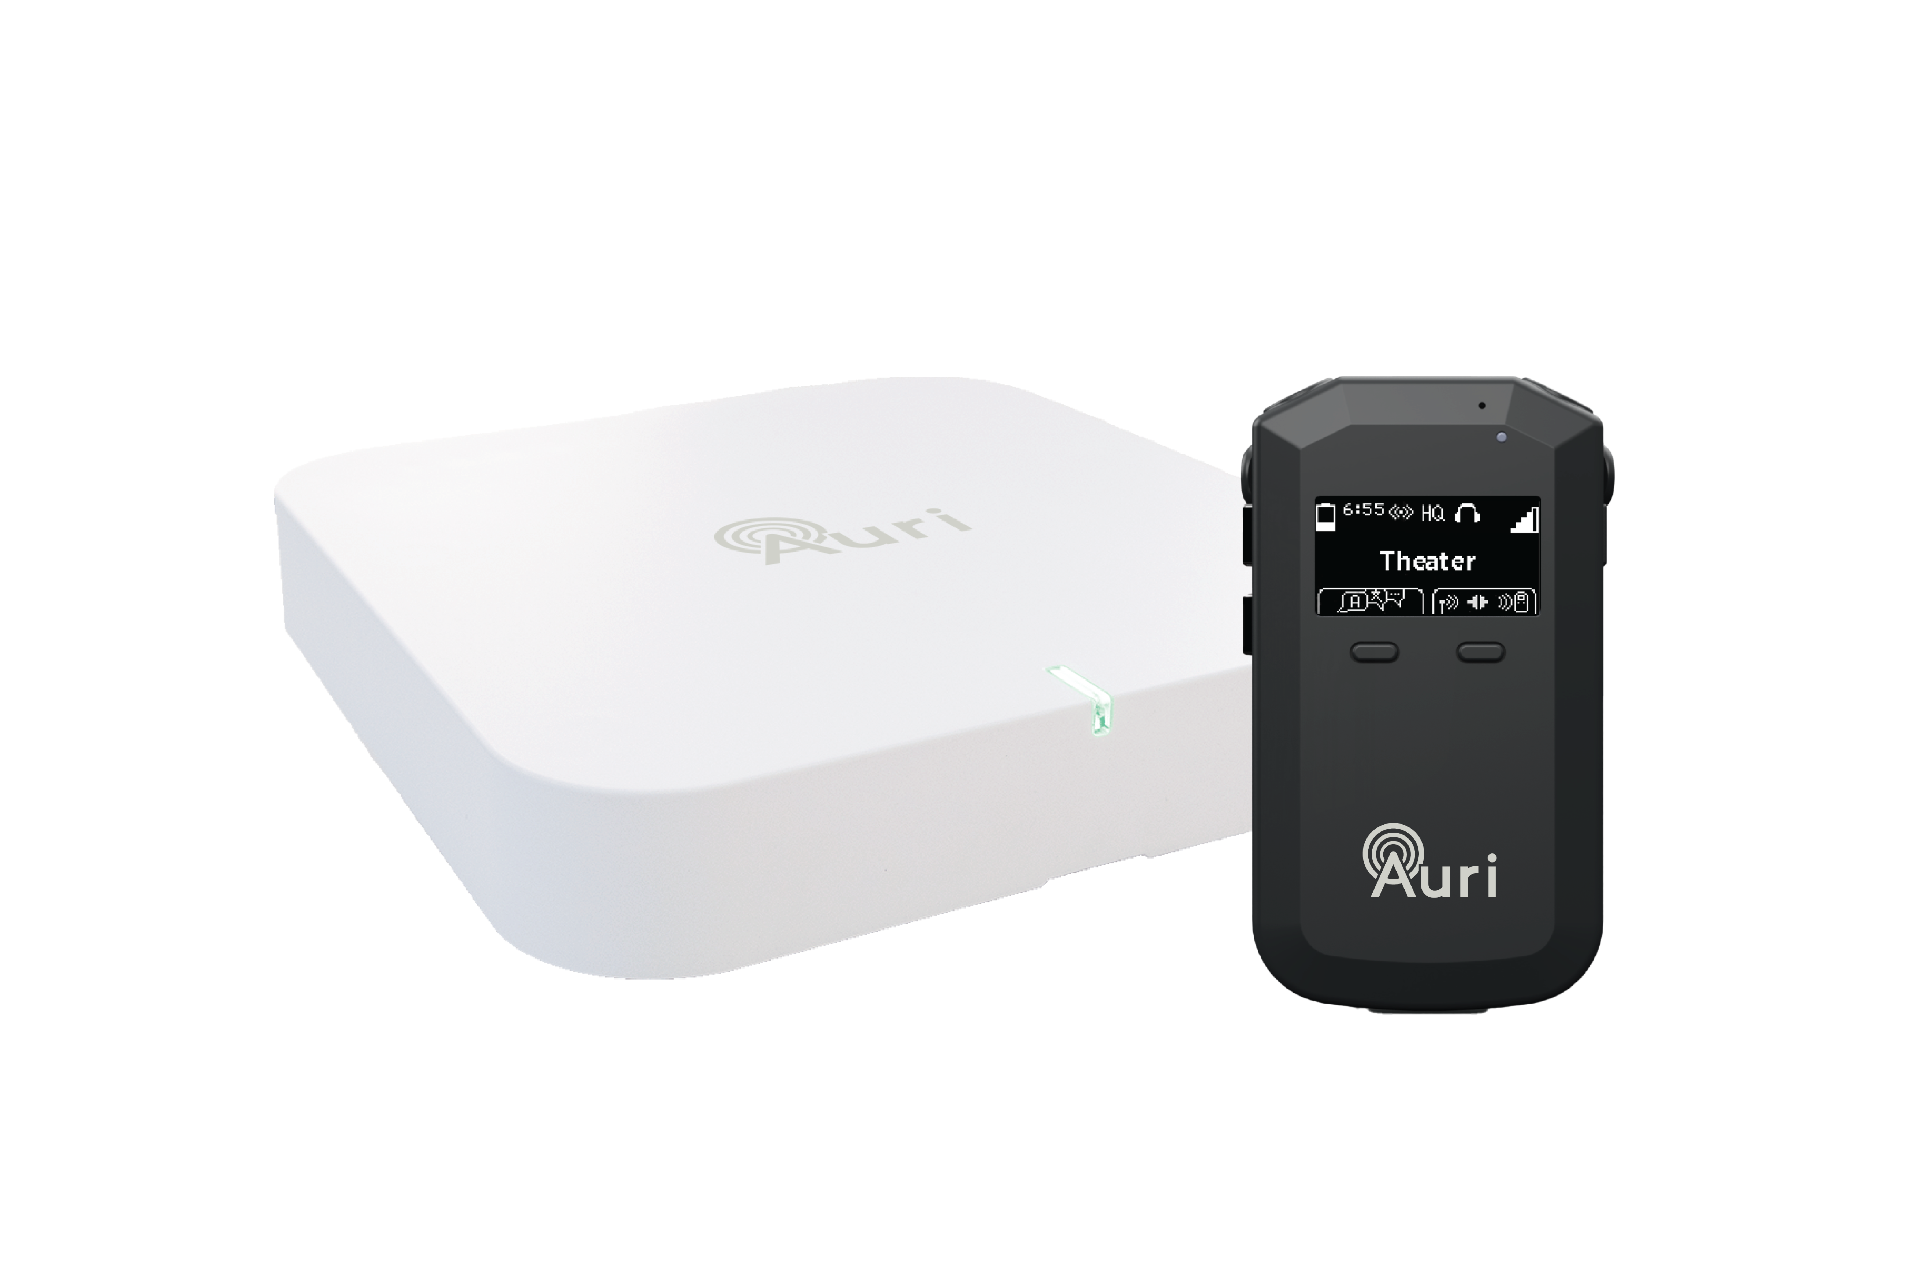
Leading the Evolution of Assistive Listening
Notes:
Listen Technologies and Ampetronic are now part of a wider accessibility group called Allvida
Auri is the product of a collaboration between the two companies combining over 60 years' experience specialising in accessible audio.
This is the first Auracast assistive listening system to be launched, targeted at the professional install market.

Slide 2
What is Auracast™?
True broadcast: One-to-many audio transmission
No need for bespoke apps – Is available now in consumer devices and will be integrated into future Bluetooth devices
Reliable, low-latency audio – ideal for real-time applications
Over 100m range in open spaces
Secure or open transmission options
Designed to meet global accessibility standards

Slide 3
Accessibility Benefits for Hearing-Impaired Users
Clear audio transmitted directly to hearing aids, cochlear implants, or dedicated receivers
Ideal for environments where traditional hearing loops may be impractical
Eliminates background noise and enhances speech intelligibility
Already supported by early consumer devices (e.g., ReSound Nexia, Samsung Galaxy Buds2 Pro)

Slide 4
Support for Neurodiverse Individuals
Enables personal audio access in noisy, overstimulating public spaces
Users can control volume and tone via personal devices
Reduces cognitive overload by eliminating ambient noise
Ideal for use in transport hubs, education, and public service points

Slide 5
Inclusivity for Non-Native Speakers
Auracast supports multi-channel transmission for multiple languages
Enables visitors to select their preferred language for public announcements
Enhances comprehension in complex environments like airports, stations, and large venues
Bridges language gaps, improving safety and user experience

Slide 6
Real-World Applications
Transport: Stations, help points, vehicles
Education: Lecture halls, classrooms
Public spaces: Museums, town halls, airports
Service environments: Ticket counters, information desks
Future-proofed: Compatible with next-gen hearing tech and consumer devices

