Slide 1
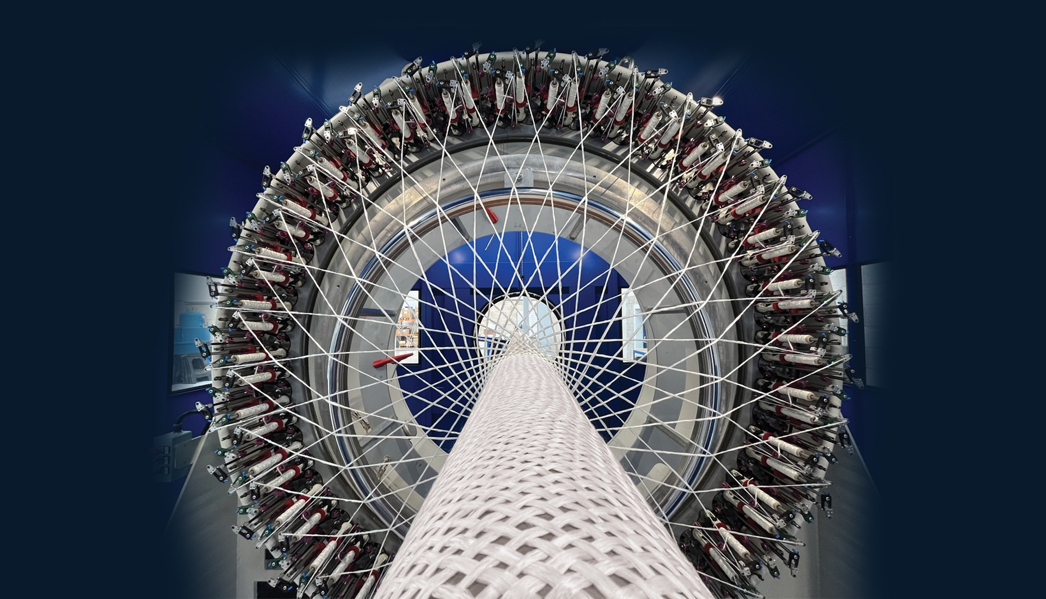
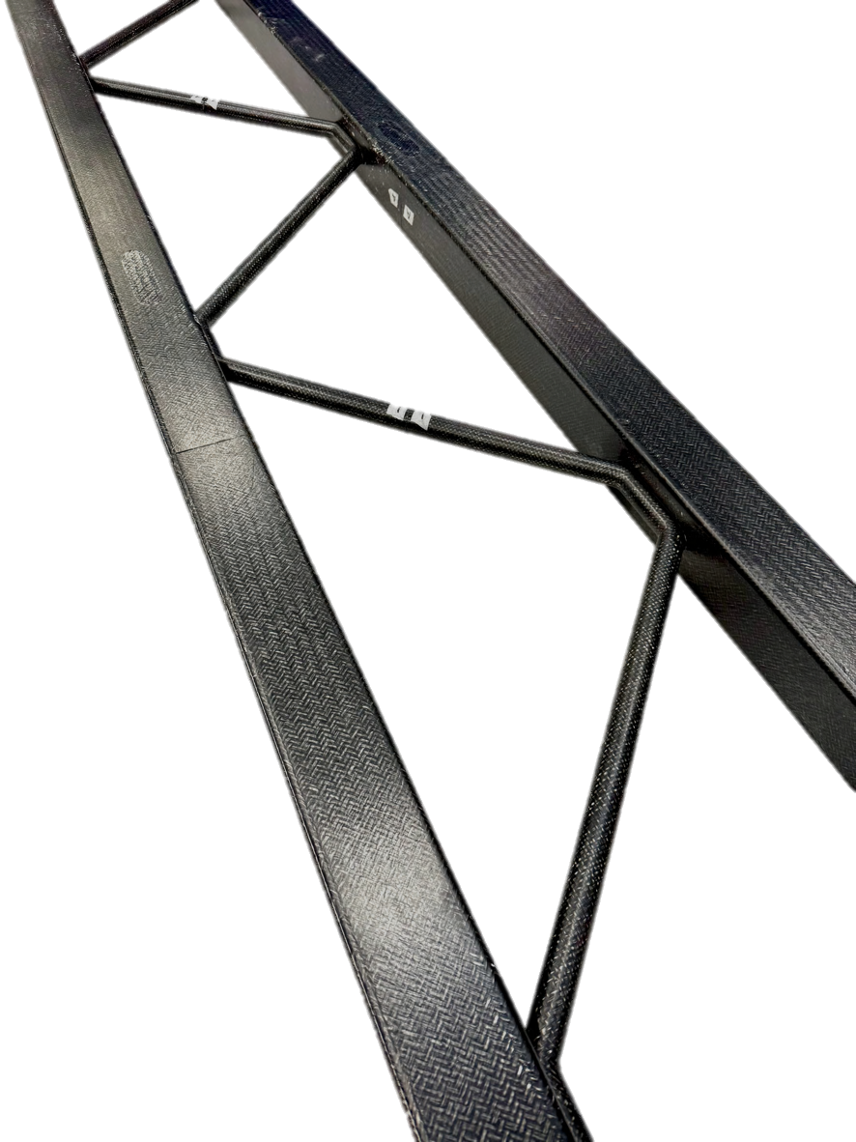
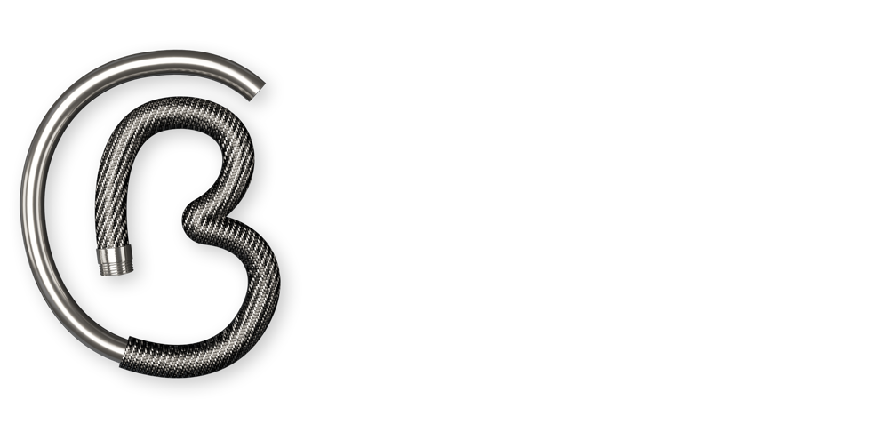

Composite Twin Track Cantilever:
Affordable & Sustainable Rail Infrastructure
Material
Glass fibre reinforced thermoplastic
Low mass – 84% weight saving vs. steel
Beneficial properties:
  Low-cost composite
  Recyclable and repairable
  Corrosion and fire resistant, low CTE (thermal expansion)
  Non-conductive
Modular – dimensions and strength are easily optimised

Slide 2
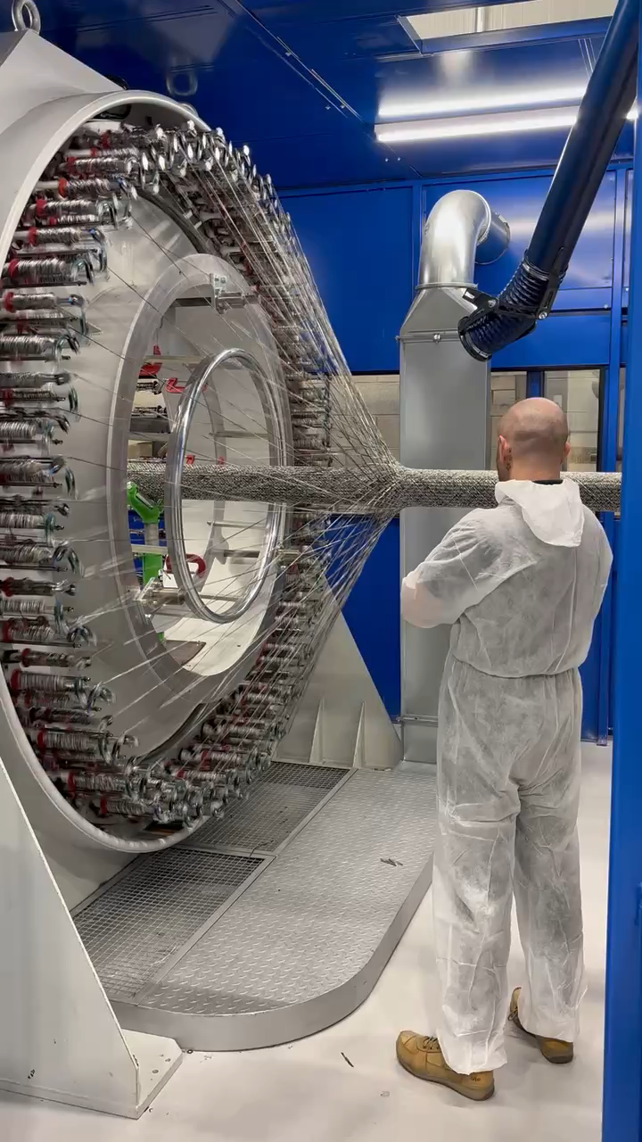
Manufacturing
High-rate
  Capacity to produce up to a mile a day of braided preform
Low waste
  Up to 98% material utilisation rate
Sustainable
  Out-of-autoclave manufacturing reduces energy consumption by up to 98%

Slide 3
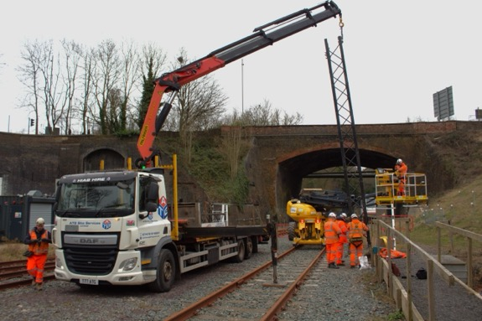
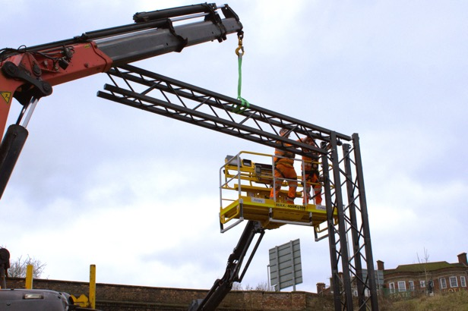

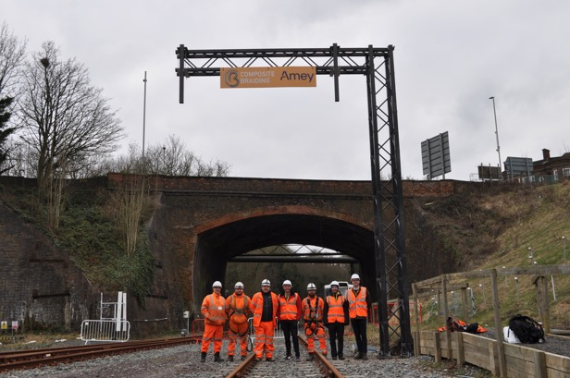
Installation
Reduced access provisions
Smaller foundations required
Increased worker safety
Decreased installation time – estimated 50% saving per unit
Significantly more efficient use of possessions

Slide 4
Lower installed cost – money saved for UK taxpayer
Reduced need for access provisions
Recyclable at end of life
Low energy production methods
Reduced transport costs
Reduced manufacture and transport emissions by up to 73%
Efficient possession usage
Capacity to use recycled material
Faster installation time
Reduced mass
Low-cost
production
Design
optimisation
Repairable in service
Sustainable
manufacture
Reduced “boots on ballast” & improved safety
Key Benefits
Up to 98% material utilisation rate
Compliant with Network Rail Standards
Variable & modular geometry
Repeatable & predictable
UK-based
Range of materials & colours
Scalable production technologies
Genuine high-volume composite production
Optimisable mechanical properties
Viable for a wide range of applications
High levels of automation
Low capital costs
Improved weather tolerance

Slide 5
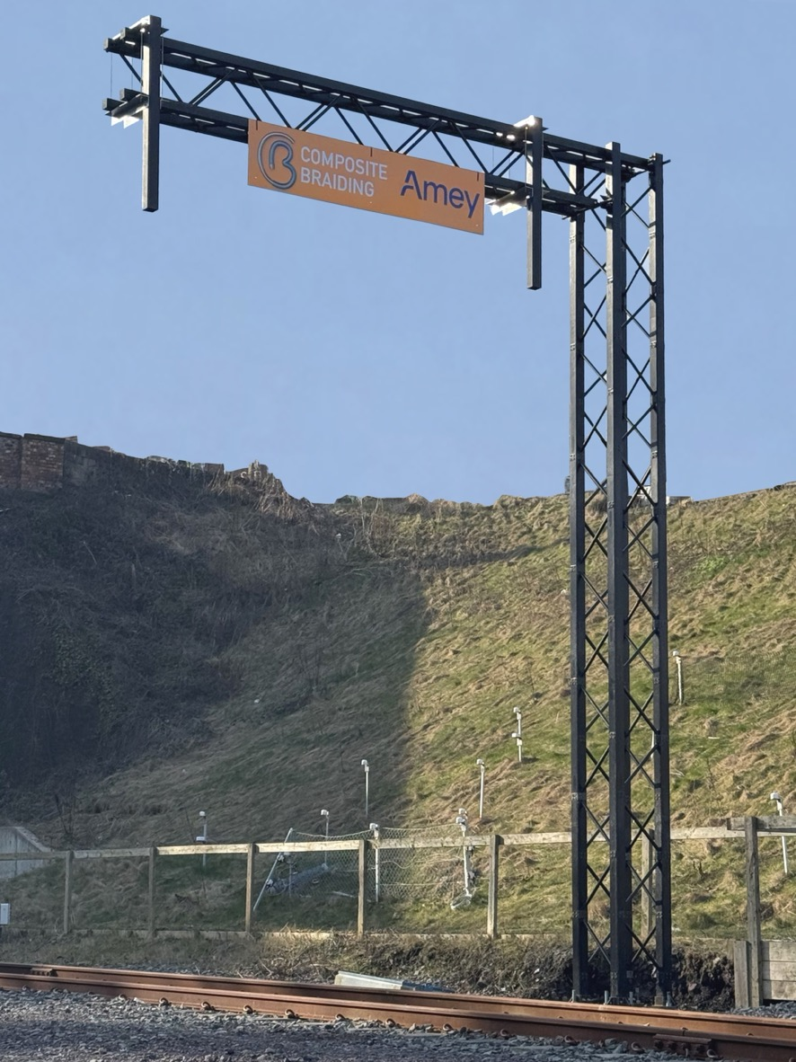




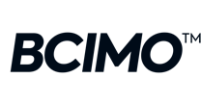
Thanks for reading
84% weight saving
80% CO₂ emission reduction
50% reduction in installation time
enquiries@compositebraiding.com
linkedin.com/company/composite-braiding-limited
01332 480106
www.compositebraiding.com

