Slide 1

What is Fenix First Fix
Simplified, Efficient, and Cost-Effective Maintenance
Improves reliability, accessibility, and maintainability Reduces downtime, saving valuable hours and cutting costs Supports PPM (Positive Preventative Maintenance)
How Does First Fix Performance Work?
We deliver regular performance reports (weekly or monthly) to identify equipment issues early. This enables proactive intervention through predictive maintenance. Routine site inspections are carried out by IRSE-qualified engineers with the goal of resolving issues during the first visit, improving system maintenance and spares management.
What Makes First Fix Efficient?
One-Visit Resolution: Issues are identified in advance. Engineers arrive prepared to resolve them during their first visit, reducing the need for follow-ups.
Transparent Reporting: Clients receive clear insights into system performance, helping reduce costs linked to spares and unplanned downtime.
What Does It Cost?
The service uses a fixed-fee structure with three tiered service levels tailored to your needs. Payment is taken via monthly direct debit, ensuring predictable costs.
Additional Information
The First Fix advanced service is included as standard for 12 months on all new installations Upgrade to Elite available if required
Compatible with all new and existing CBI systems

Slide 2



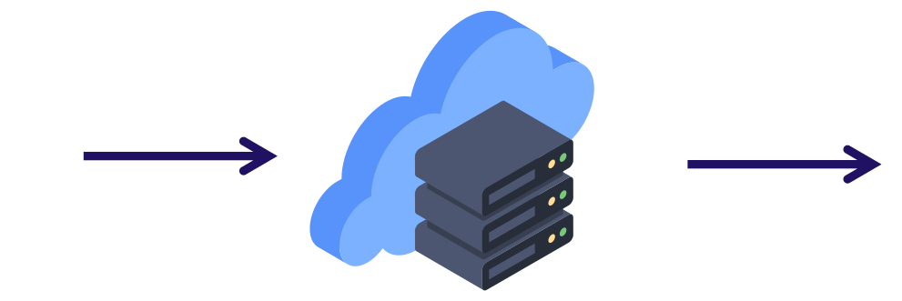
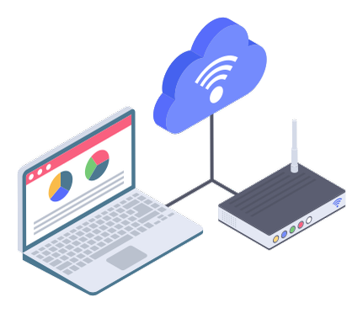
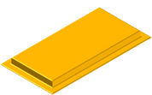





Fenix First Fix IoT Service
2
4
IoT Data stored on Fenix Systems at Depot
Fenix Cloud Platform analysis and report generation
1
3
5
Fenix Control Systems IoT data captured daily
IoT Gateway sends IoT Data to Fenix Cloud Platform
Maintenance Action Reports sent to Engineer for onsite FirstFix visit

Slide 3
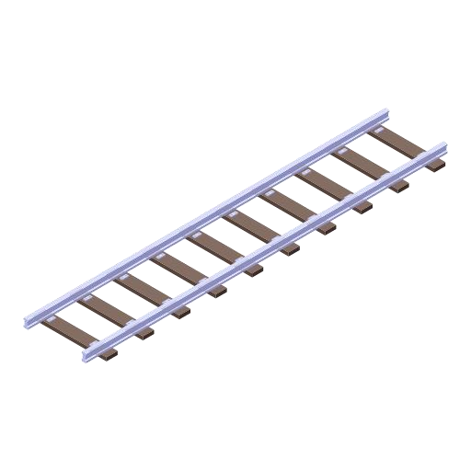

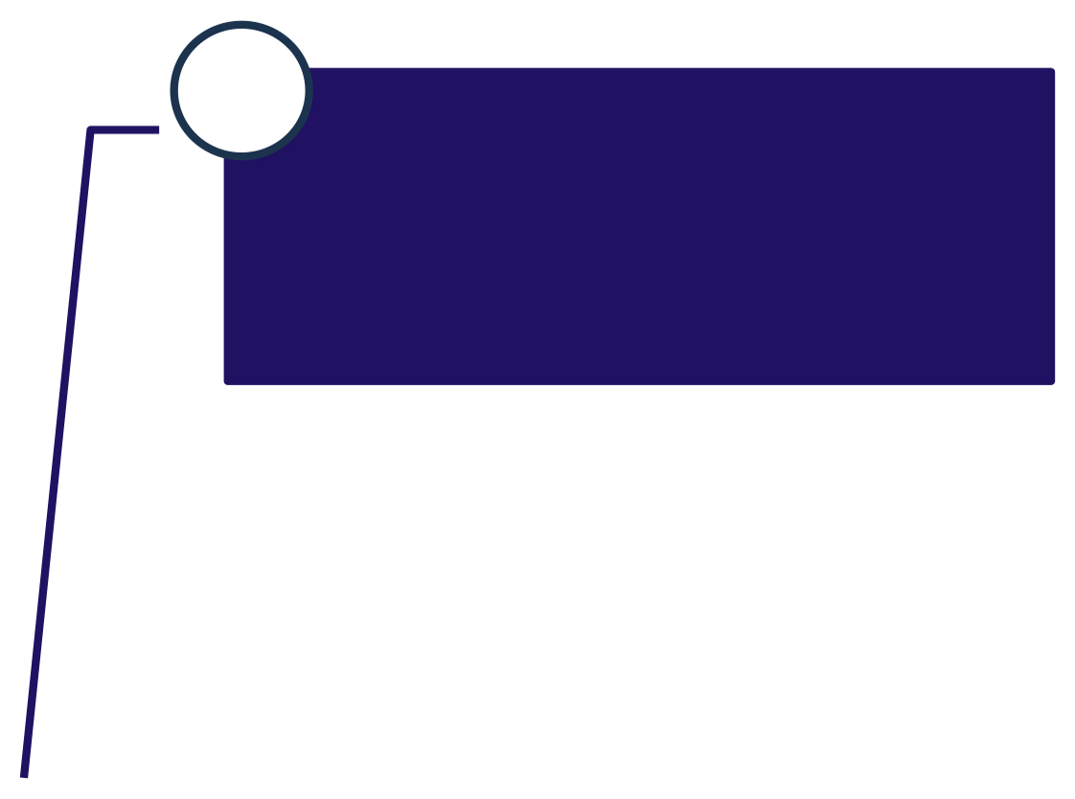

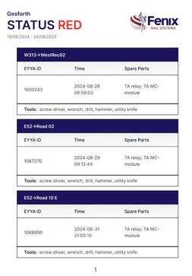





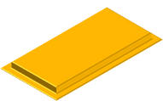








First Visit – First Fix
1
Engineer receives detailed reporting from Fenix Rail Depot Control Systems.
3
Engineer has correct parts and correct tools on hand.
4
Engineer has step by step instructions to diagnose and troubleshoot before resorting to spare part replacements.
2
Engineer knows the section of track or server component that needs addressing.
5
Engineer delivers a first visit first fix outcome.

Slide 4
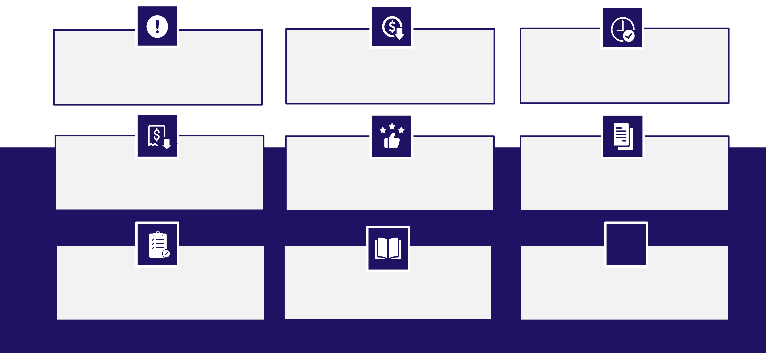
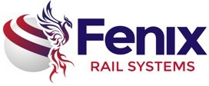
Core Benefits
On same visit engineer will also address other issues
Reduce cost of maintenance
Ensure trains leave depot on time to avoid network delays
Reduce/Avoid unnecessary network rail fines
Improve customer satisfaction
Visibility of previously
‘undetectable’ track issues
Inventory of all depot management equipment
Improve knowledge of operators

Slide 5

Cost Saving Benifits
1
Reduced reactive maintenance: Reduced number of reactive maintenance call outs gives reduced
annual maintenance cost.
Reduced downtime: Less system failures eliminates / reduces operational down time and associated management effort and staffing.
Enhanced safety: Less system failures eliminates / reduces operational down time and reduces the likelihood of a safety incident occurring whilst in degraded mode working.
Reduced reactive maintenance: Reactive maintenance callouts are resolved more quickly and reduces operational downtime, saving / reducing TOC / FOC train delay penalty fines.
Reduced overall maintenance costs: Optimisation of maintenance spares, less wastage gives reduced annual cost.
Improved budget planning: Annual maintenance costs are known in advance, reduced risk of going overbudget and having to transfer budgets from elsewhere.
Improved asset reliability: System failures will be less significant, reducing the operational and cost impact.
Increased lifespan of assets: Regular inspections, services, and repairs are scheduled in advance to maintain the condition of the system and equipment, thereby extending the lifespan of the assets.
Improved productivity: Reduced downtime and improved asset reliability contribute to increased productivity.
Improved asset performance: Regular targeted maintenance ensures that assets are performing at their optimal level.
2
3
4
5
6
7
8
9
10

