Slide 1

Introducing L.B. Foster
Digital Help Point
ERCI Innovation Awards 2025
Packed with intelligent features to enhance travel experience The Help Point empowers passengers to navigate their journeys with confidence and independence.

Slide 2
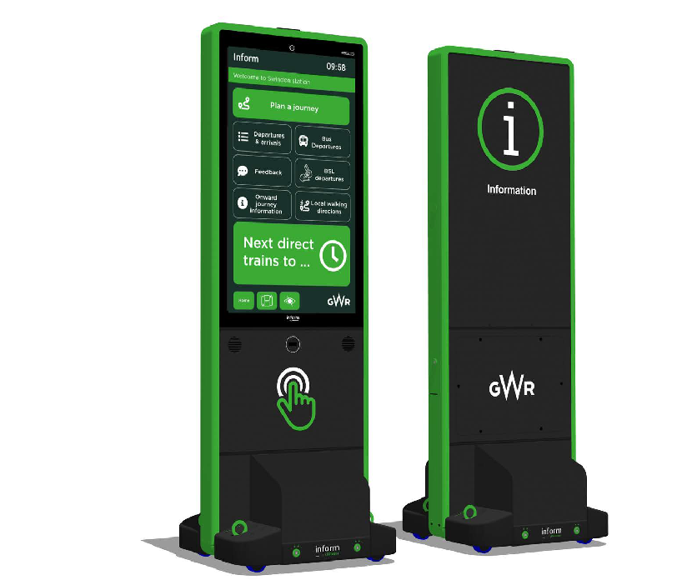
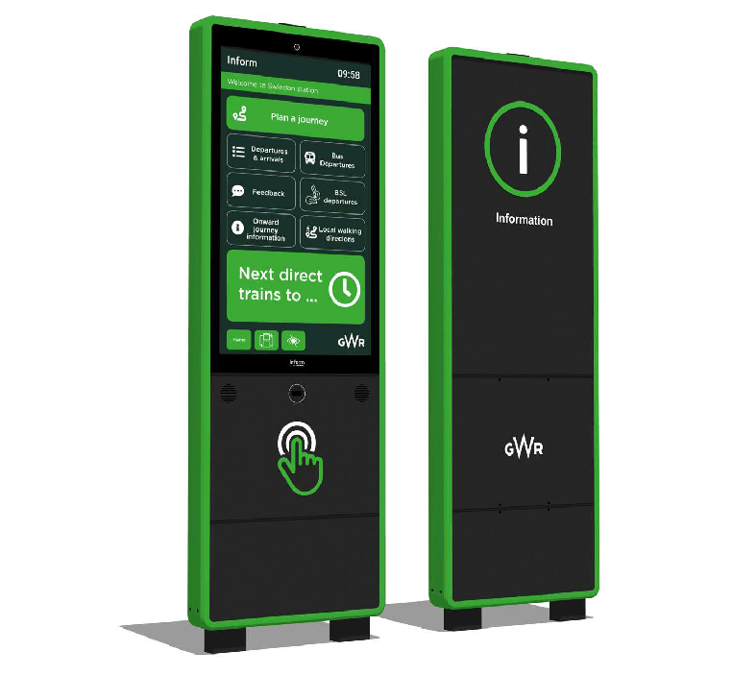
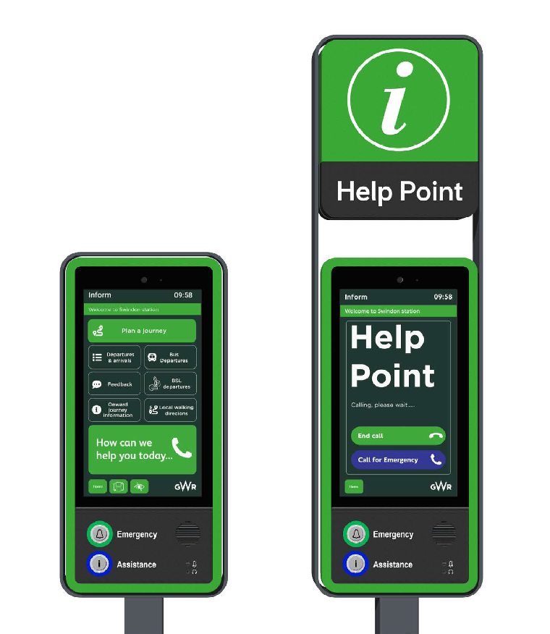
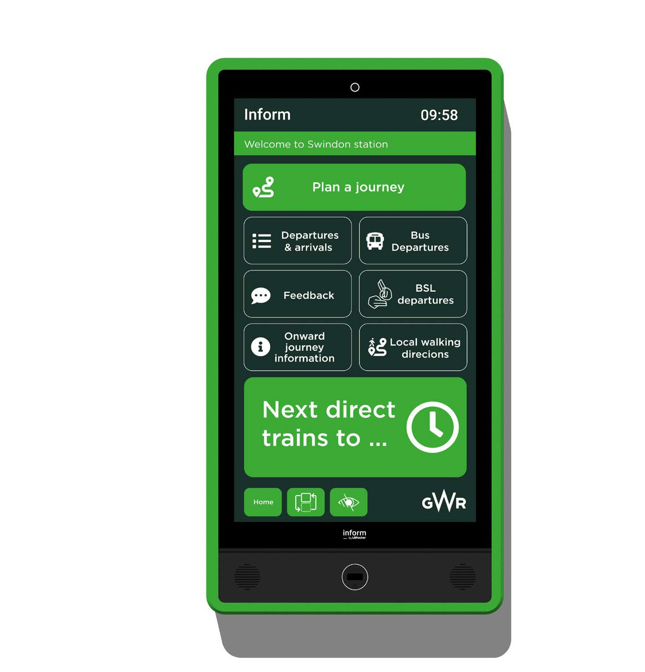


The Help Point provides unmatched flexibility for deployment in any location. Its design seamlessly integrates into your space, adapts to diverse environments, and embodies your unique brand identity.
Four universal designs
Battery or mains-powered
Wireless Technology
Integrated 3G / 4G mobile communications
Touch screen technology
Universally designed interface
Cutting-edge functionality
Pioneering accessibility features
Fully customisable
Intelligent features

Slide 3
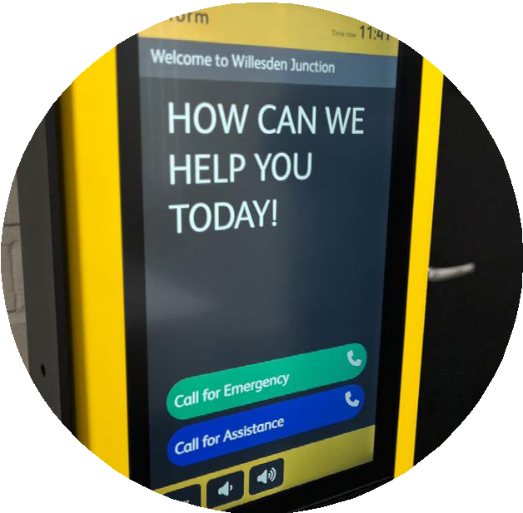
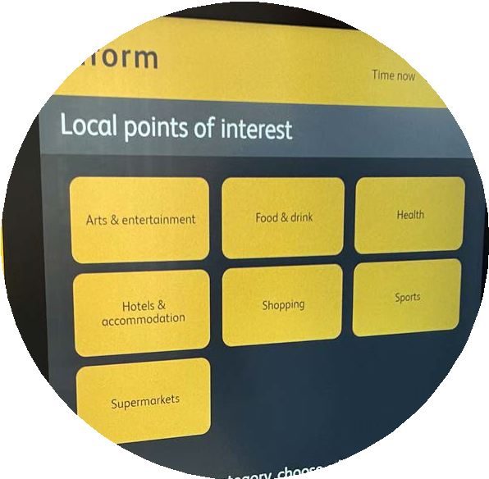
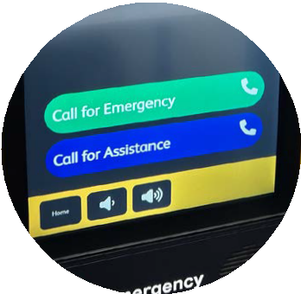
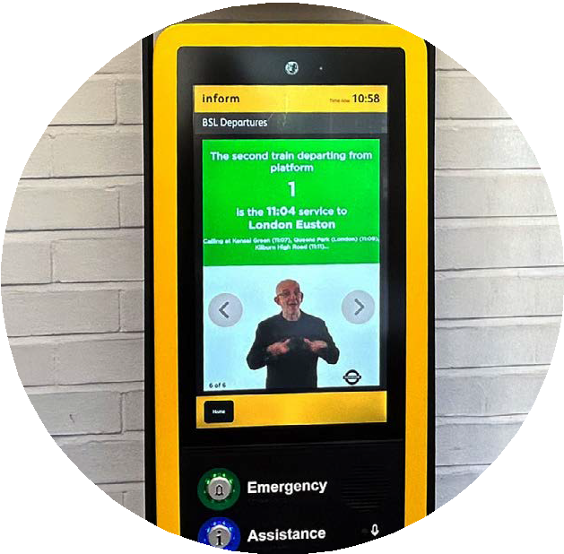
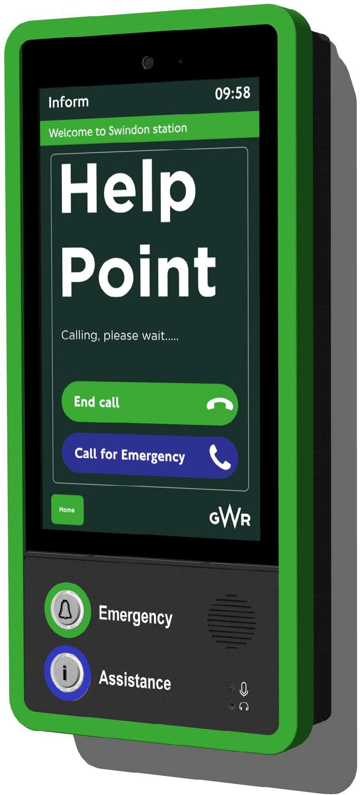

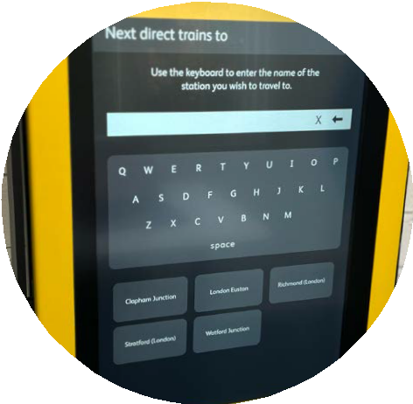
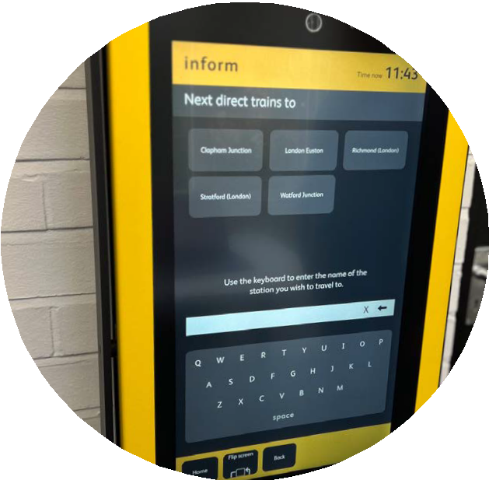
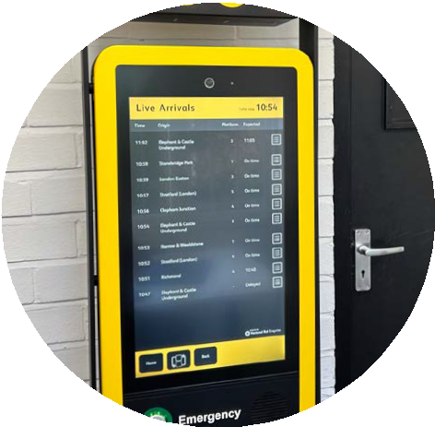
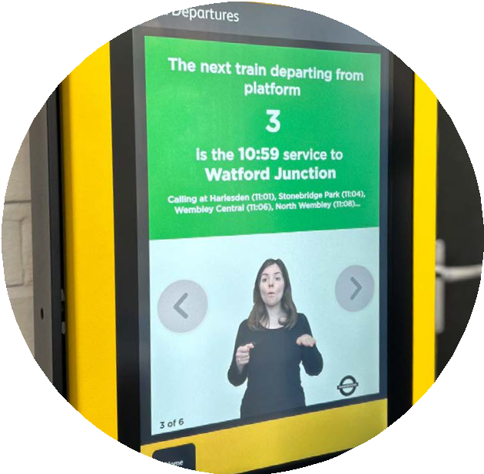

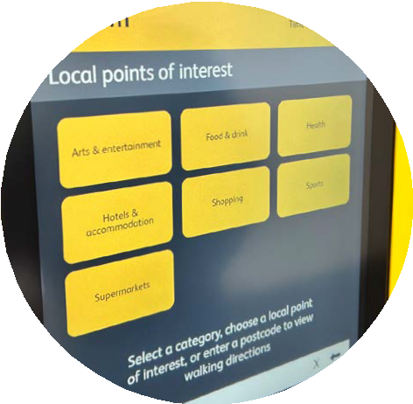
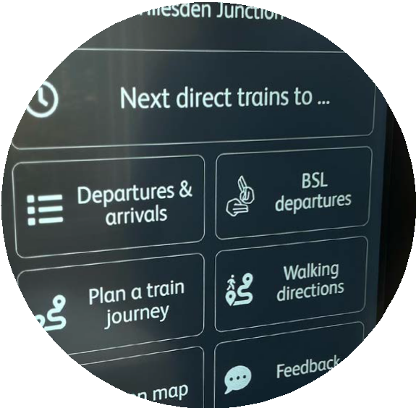
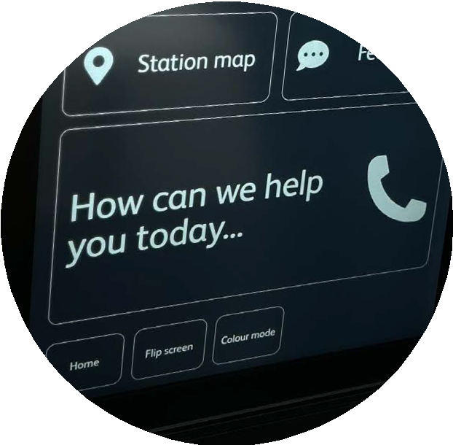

Live Call Functionality
Enables passengers to directly connect with station staff for personalised support.
Intelligent Features for enhanced travel experience.
Step-by-Step Walking Directions
Downloadable via QR codes, these directions provide passengers with peace
of mind and clarity.
British Sign Language (BSL)
Train updates tailored to the Deaf community.
Adjustable Touchscreen
Designed for wheelchair users.
British Sign Language
Live Call Functionality
Step-By-Step Walking Directions
Adjustable Touchscreen
High - contrast Display Modes
Multi - Language Support
Real - Time Train Updates
Real-Time Train Updates
Accurate and up-to-the-minute information ensures passengers are well-informed.
High-contrast Display Modes
To support visually impaired passengers
Multi-Language Support
International travellers can easily overcome language barriers.

Slide 4
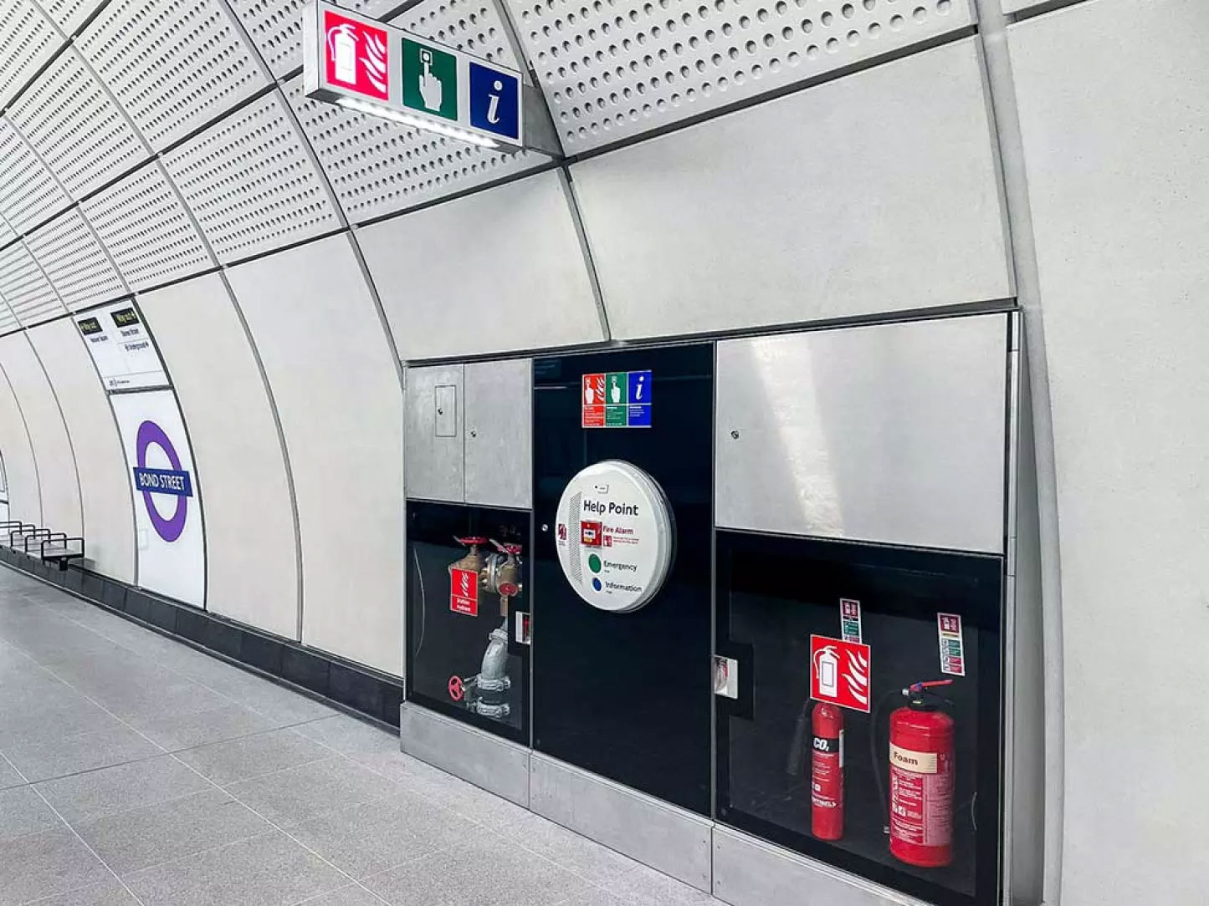
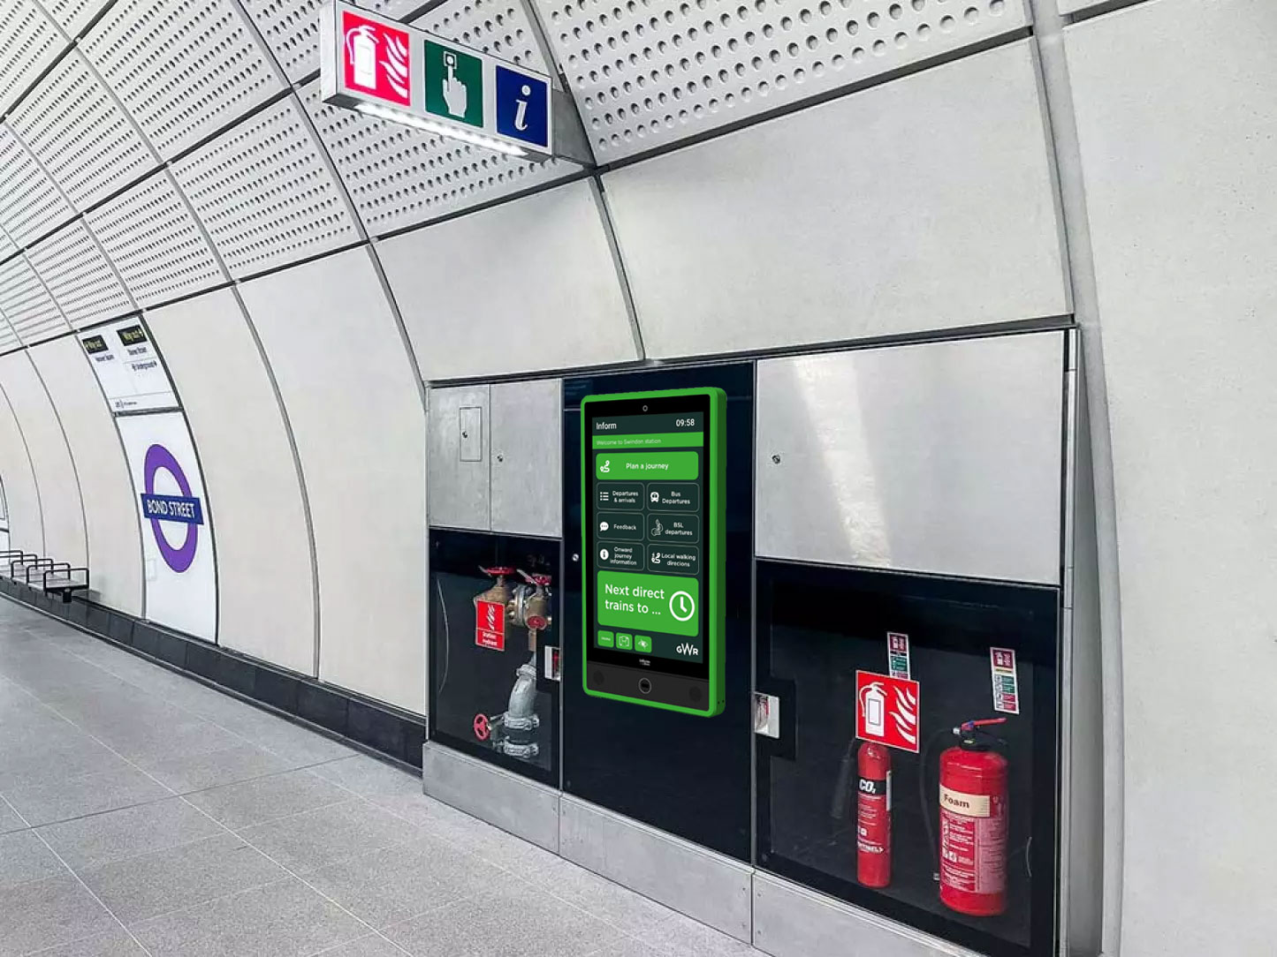
Traditional Help Points Failing Across England’s Rail Stations—A Quarter Left Unusable Since 2023
For decades, passengers have relied on traditional ‘Pill’ Help Points—basic call buttons with limited functionality and uncertain reliability. The inconsistency in maintenance of traditional ‘Pill’ Help Point leaves passengers vulnerable, unable to seek immediate support when faced with security threats, health emergencies, or travel disruptions.
Traditional
‘Pill’ Help Point
L.B. Foster
Digital Help Point
A November 2024 report from the Office of Rail and Road (ORR) exposed a deeply troubling reality: since April 2023, an astonishing 25% of audited railway stations in England had at least one help point completely nonfunctional during inspections. These critical lifelines—meant to provide urgent assistance—were failing passengers when they needed them most.
Recognising the need for change, L.B. Foster’s Digital Help Point introduces a paradigm shift, blending cutting-edge technology with user-focused design. More than just an emergency button, this next-generation device features both tactile call buttons and an intuitive touchscreen interface, empowering passengers to request help or access real-time travel information across rail, bus, tram, and airport services with ease.

Slide 5
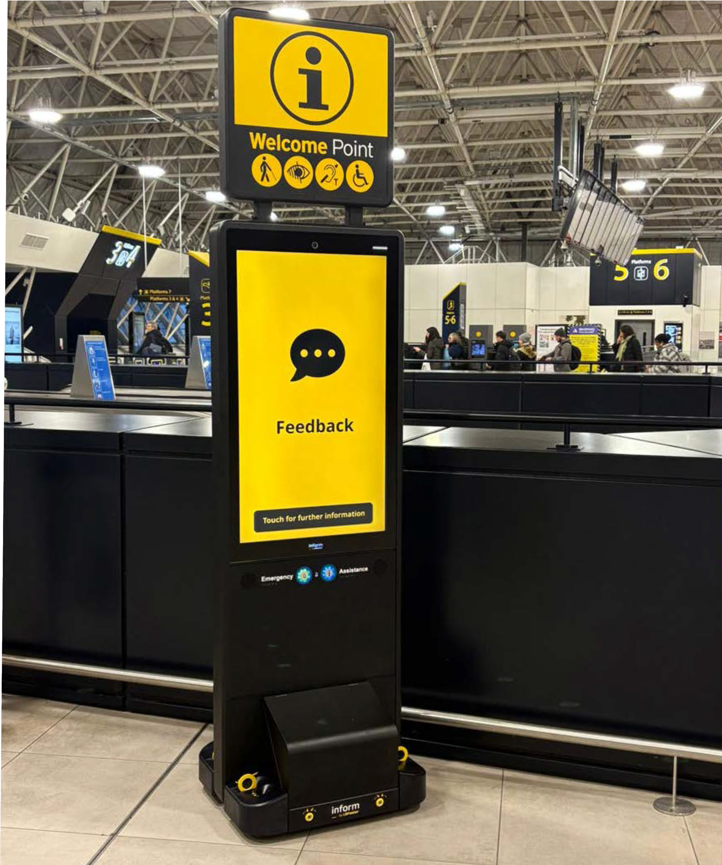
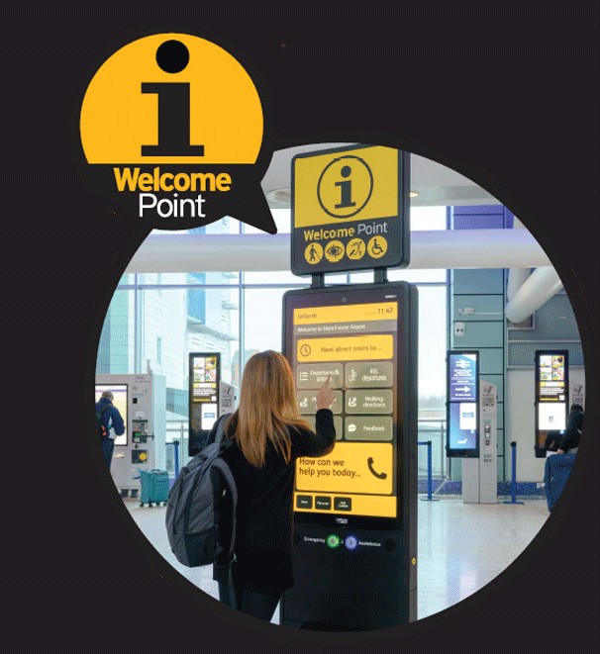
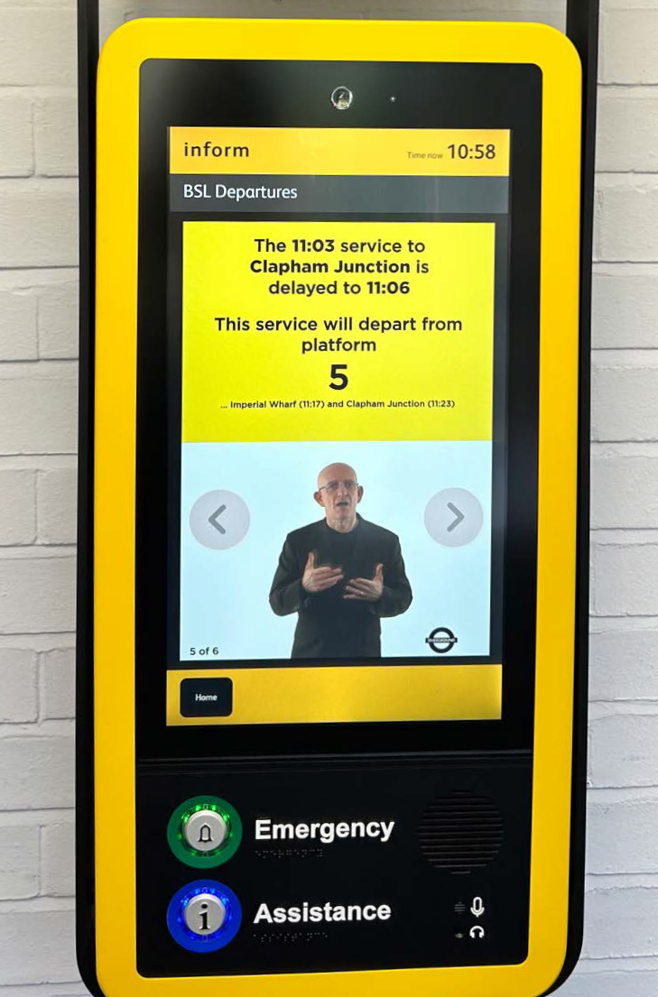
Case Study: Welcome Point Trial
In collaboration with the Rail Delivery Group (RDG), train operating companies, accessibility organisations, and passenger advocacy groups, L.B. Foster has supported RDG’s roll out of the groundbreaking Welcome Points trial across the rail network.
The core challenge was to design technology that is universally accessible, user-friendly, and responsive to diverse passenger needs. Ensuring seamless interaction for individuals from various backgrounds, including those with disabilities. The easily recognisable yellow on black Welcome Point design, provides a focal point in stations so that customers can find a place to go for assistance and information when they arrive at a station, including those who have a range of disabilities and dual sensory loss.
The designs have incorporated specific accessibility requirements that aim to meet the needs of wheelchair users, include the latest British Sign Language (BSL) translation technology to better support Deaf passengers, and provide new ways for visually impaired passengers to locate the Welcome Points and call for assistance.

