Slide 1

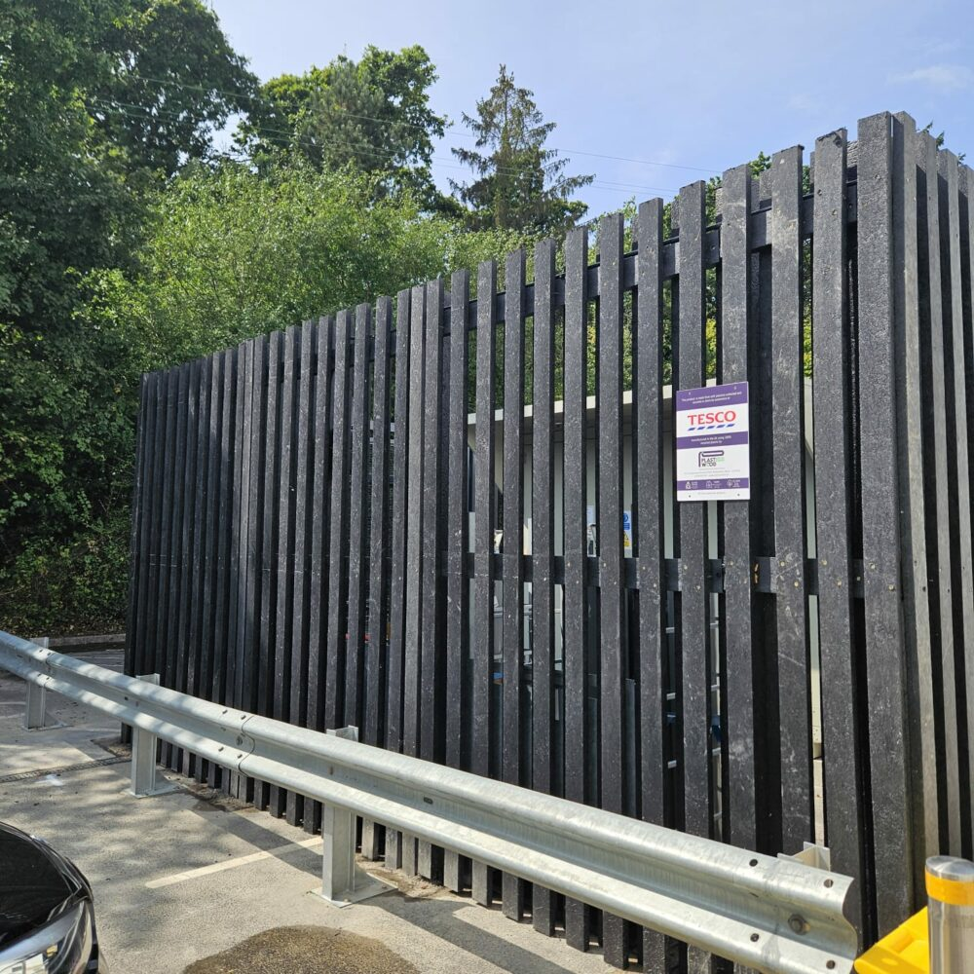
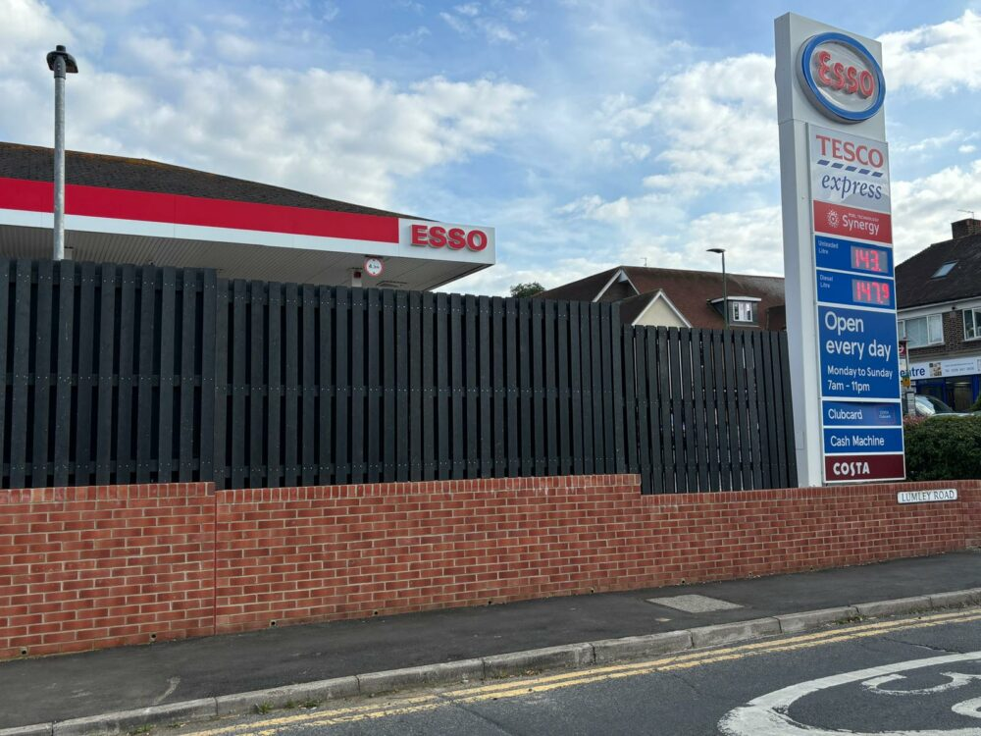
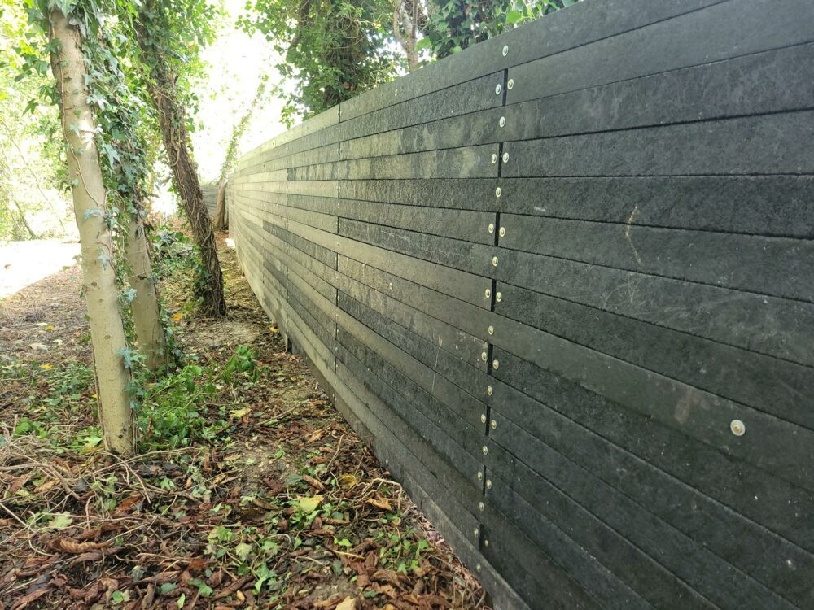
Introducing Smartawood™ – A Circular, Carbon-Negative Innovation
Transforming Waste into Durable Infrastructure
Smartawood™ is a proprietary material made from 100% recycled mixed plastic packaging waste.
Offers a sustainable alternative to timber, steel, and concrete.
Supports circular economy principles by repurposing waste into long-lasting products.
Image:
Fencing panels in a real-world setting, at a variety of Tesco locations.
See the company, process and products in 1 minute here

Slide 2
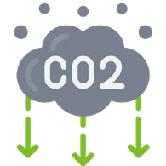







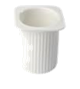
Stronger user benefits of SmartawoodTM products vs timber, steel and concrete
Even an amazing sound barrier - UKAS tested to above 44dB
Ecological Commercial
Practical
700 kg of carbon captured in each tonne
2500kg CO2 avoided compared to waste incineration for each tonne
Water & weather
Iimpervious
Low slip
Price competitive
versus wood, steel and concrete
2.5 trees saved
per tonne
Allowing continued CO2 absorption by the trees
Closed loop -
100% recyclable
Fungi & rot
resistant
Repurpose >25,000 single use plastic packages per tonne
Expected life in excess of 100 years - BBA
Extremely durable
& maintenance free
Source: Company information

Slide 3

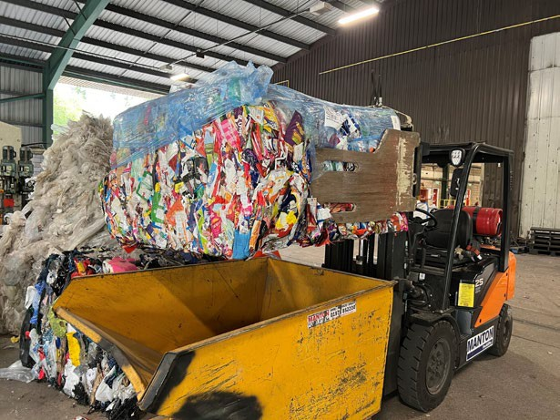

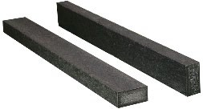
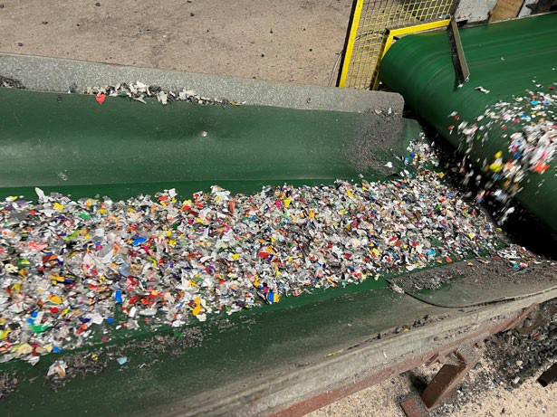
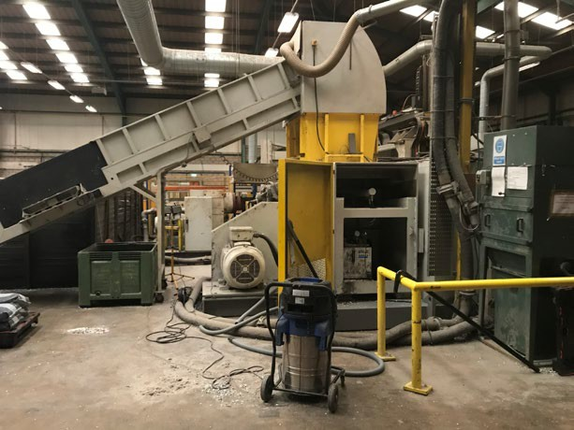
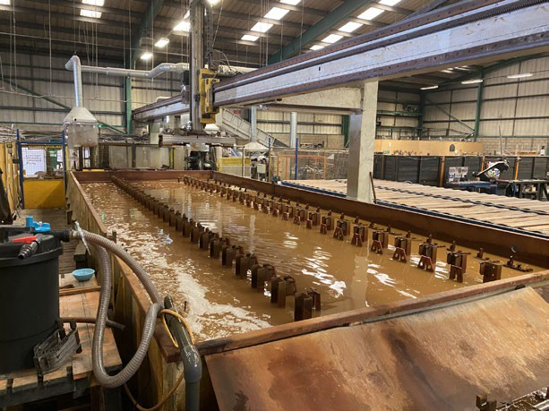
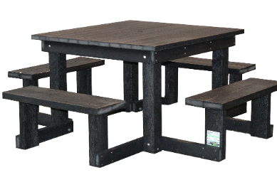
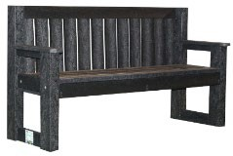
Plastecowood has a proven process and proprietary know-how
Unique technology and process was developed and perfected over ten years
Waste plastics
Confidential know-how, only heat and colour inputs alongside mixed plastic packaging waste
UK manufacturing success story
Bottles, pots, lids, caps – even flexible plastics like crisp packets
Lumber
Shredding
Extrusion
Cooling
Assembled products
100% Fully recyclable products
Source: Company information

Slide 4
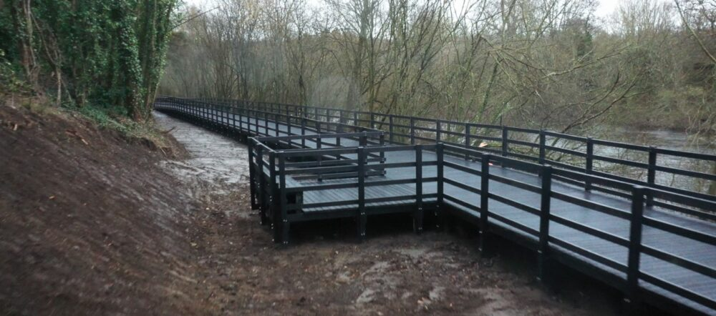
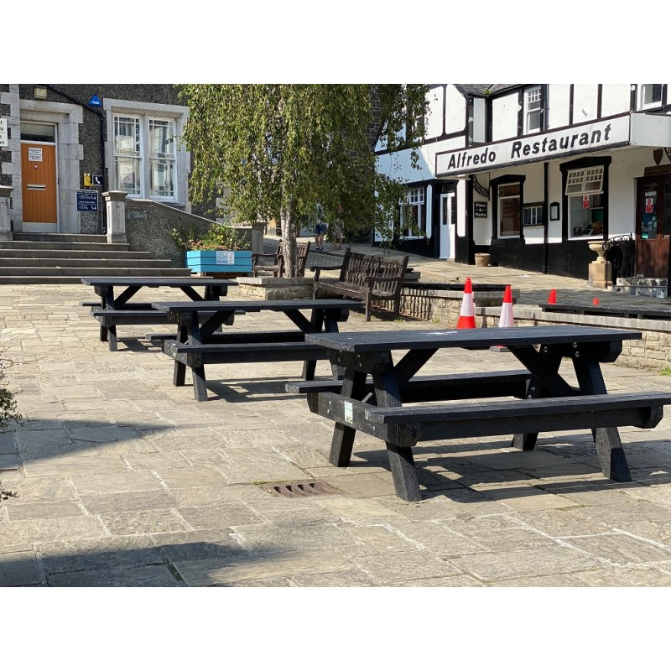
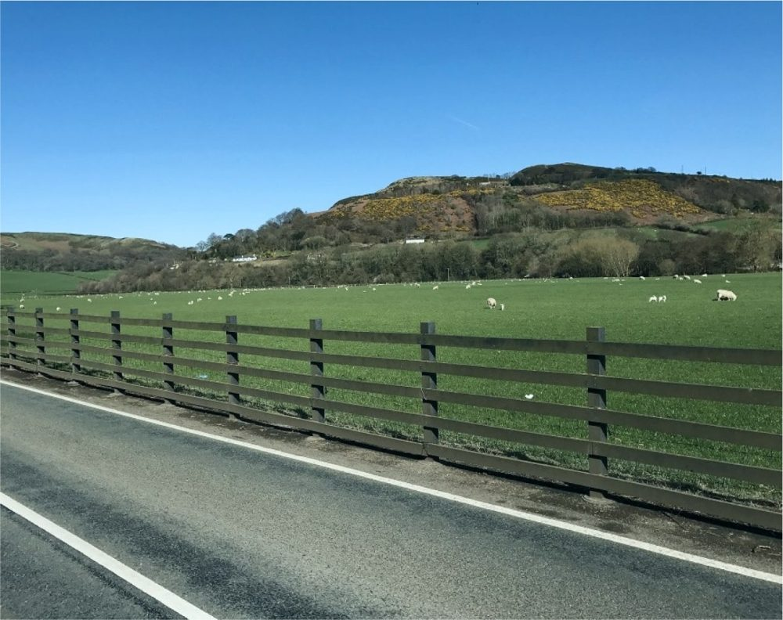
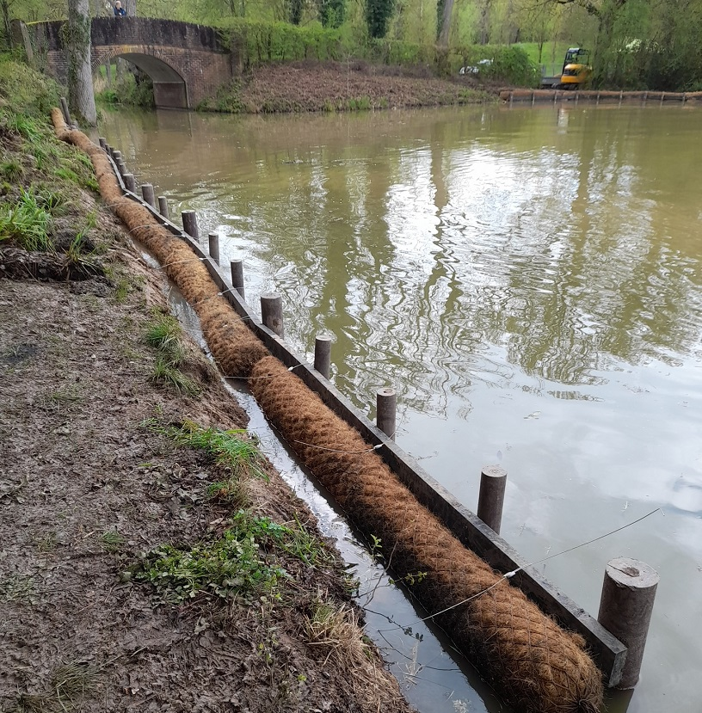
Versatility Across Applications
Adaptable Solutions for Diverse Needs
Smartawood used for this boardwalk in Ireland:
Saved 408 Tonnes of CO2 released into the atmosphere
Saved 408 trees being cut down
Upcycles at least 10.2 Million single use waste plastic packages
Smartawood™ is utilized in various applications, including:
  Boardwalks and walkways.
  Outdoor furniture for public spaces.
  Canal retaining walls.
  Acoustic barriers
  Shipping structures and pallets
Its properties make it suitable for both urban and rural infrastructure projects.
Images:
A collage of Smartawood™ applications, such as boardwalks, benches, and canal walls, demonstrating its versatility.

Slide 5

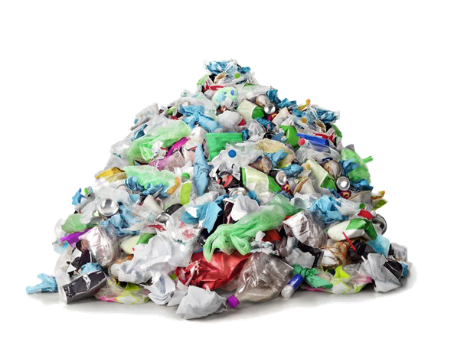
Policy should be to “upcycle” waste into something else -
stop the killing of forests AND replace carbon intensive products
Global plastic waste production could nearly treble by 2060¹ Only 9% of global plastic is recycled²
1,014
Recycled 9%
Mismanaged 22%
Tonnes (millions)
2.7x
381
156
Incinerated 19%
Landfilled 50%
2000
2010 2020 2030 2040 2050
Investment in plastic treatment is ramping up³
2060
Need to abate global CO₂ emissions significantly⁴
Smartawood™ supports:
  The European Green Deal by reducing reliance on virgin materials.
  Circular economy initiatives through recycling and reuse.
  Net Zero targets by lowering greenhouse gas emissions.
Encourages sustainable practices in construction and manufacturing sectors.
Source: 1 - OECD, Global Plastics Outlook Policy Scenarios to 2060 (June 2022); 2 – OECD (February 2022); 3 – P&S Intelligence, Growth in Recycled Plastic Market (April 2022); 4 - World Economic Forum January: Production and incineration of plastic globally in 2019 (2022)

