Slide 1
MOBILE MAPPING FOR OLE SURVEY & ANALYSIS PRESENTATION

Slide 2


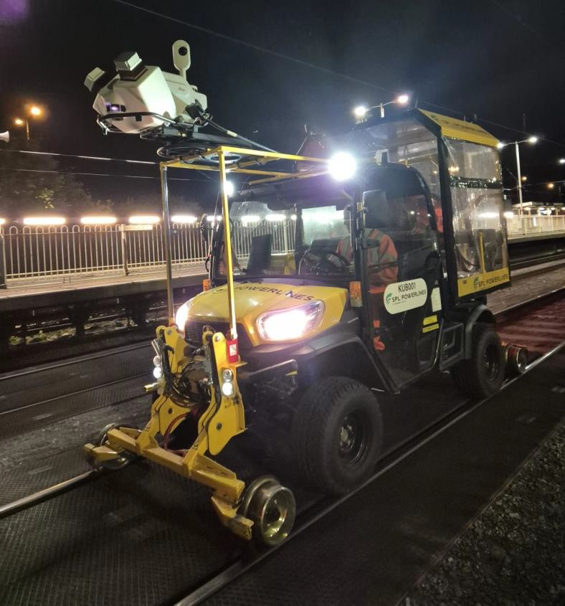
MOBILE MAPPING FOR OLE ANALYSIS & SURVEY
- THE PROBLEM
The industry needs fast and accurate mapping data to reduce the Single-Track- Kilometre (STK) cost rate on new-build & modifying existing electrification.
Voltage Controlled Clearance (VCC) & reductions in allowable clearances means
that the data needs to be much more than just traditional topographic surveys.
Further analysis with sophisticated software needs large volumes of high- resolution data quickly, in order to get meaningful results.
The data capture needs to be timed to suit the data need.
The data needs to be accurate ‘enough’ to accomplish the goal – a minimum viable product.
The data needs to reduce the amount spent on Test Trains or Train-Borne or Traditional Site Survey methods.
ONE TEAM • ONE VISION • ONE GOAL THE JOURNEY TO CARBON NET ZERO

Slide 3

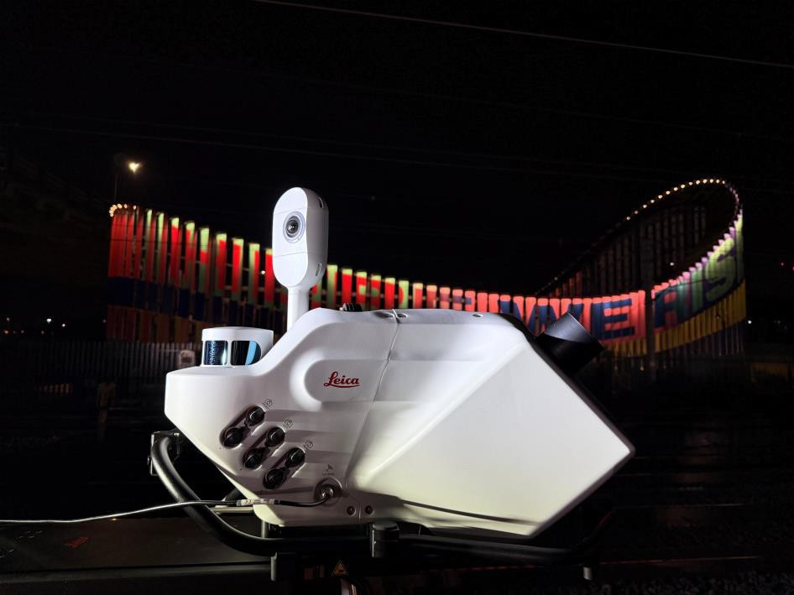
THE SOLUTION – RRV MOUNTED MOBILE MAPPING SYSTEM
SPL POWERLINES PEGASUS TRK700 SYSTEM
A sophisticated solution for Mobile Mapping – Owned by SPL Powerlines
Highly accurate Lidar Based Mapping System.
Can be mounted to any Road Rail Vehicle
Fast data capture at 5 to 75mph of all tracks in the corridor whilst
only running on one.
Gives high resolution data of the full corridor with a relative accuracy of +/-5mm and an absolute accuracy of +/-35mm.
Uses software and plant that SPL Powerlines already owns in order
to create streamlined workflows to increase productivity.
ONE TEAM • ONE VISION • ONE GOAL THE JOURNEY TO CARBON NET ZERO

Slide 4

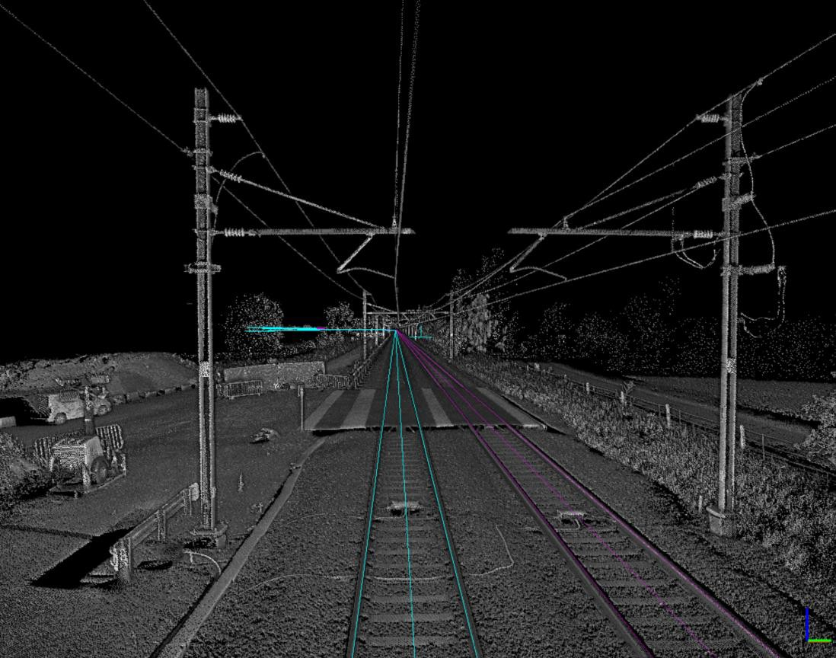
THE OPTIONS – RRV MOUNTED MOBILE
MAPPING SYSTEM – SAMPLE OUTPUT
A Fully Geo-referenced PointCloud
Surveys covering ALL tracks in the corridor but only needs to run on one track, and in one direction as a minimum.
High resolution OLE strings – measurements
every 10mm possible.
Can be used for clearance gauging or proof of electrical clearance.
SPL Powerlines provide the system, mounting and vehicle along with operators and processing.
ONE TEAM • ONE VISION • ONE GOAL THE JOURNEY TO CARBON NET ZERO

Slide 5
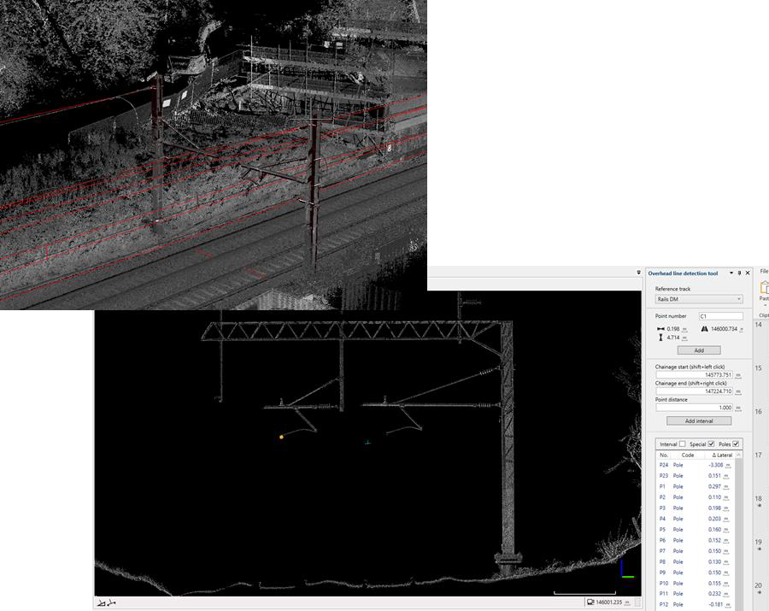
CLASSIFICATION & AS-BUILT ANALYSIS OF CAPTURED DATA
Data can be classified into feature groups such as:
Ground Form
OLE
Rails
Sleepers
Ballast
Lineside Furniture
High Vegetation
Low Vegetation
This allows rapid processing of data into topographic outputs.
By simply importing the OLE AFC designs into the processed PointCloud it is possible to quickly & visually check if the installation is as per the design.
In the image adjacent, you can see that it is possible to check if the correct mast/boom/SPS has been installed in 3D.
The same can be done with elevations.
Anything can be measured – ACCURATELY from the captured data.
Measurements can be taken from centreline, high rail, in plane of rail or perpendicular to gravity.
Height & stagger can be analysed at ANY point on the run of ANY Wire.
Already we have avoided snagging revisits by looking at digital data instead of visually with an RRV.
ONE TEAM • ONE VISION • ONE GOAL THE JOURNEY TO CARBON NET ZERO

Slide 6

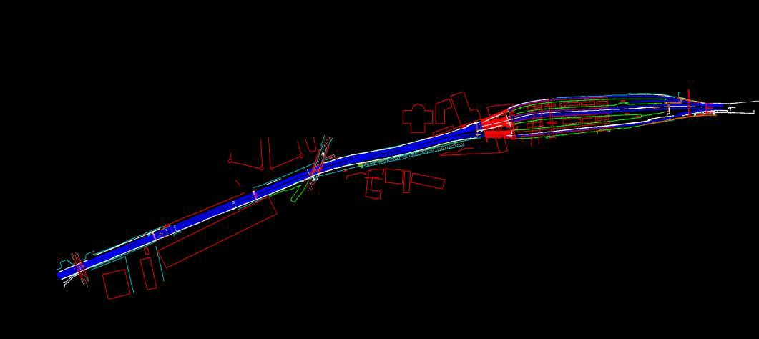
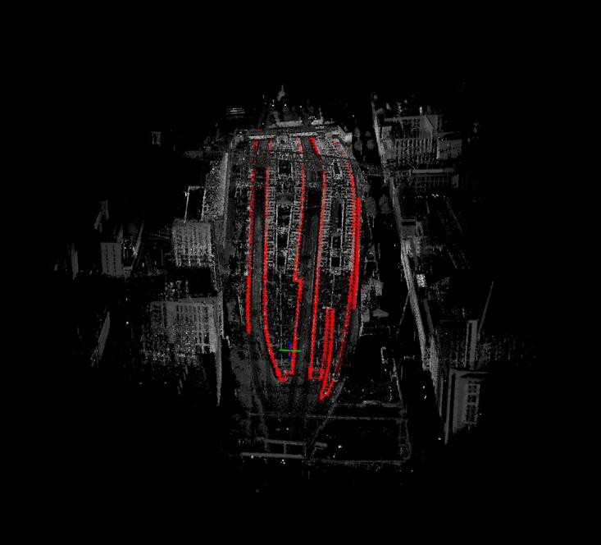
WHAT ELSE CAN WE DELIVER?
FEATURE EXTRACTION FOR BIM/DESIGN BASE DATA/8PT TOPO
With the final georeferenced PointCloud, this can be classified and exported to be sent on for feature extraction of all topographic details within the site.
The feature extraction model forms the basis of the BIM Federated Model.
Further processing can be used to leverage the ‘Multiple Return’ LiDAR Sensor on the system to remove all surface details and create a DTM or digital terrain model which allows rapid and accurate calculation of slope angles etc. for foundation design.
All foundation calculations are now done from this data.
ONE TEAM • ONE VISION • ONE GOAL THE JOURNEY TO CARBON NET ZERO

