Slide 1

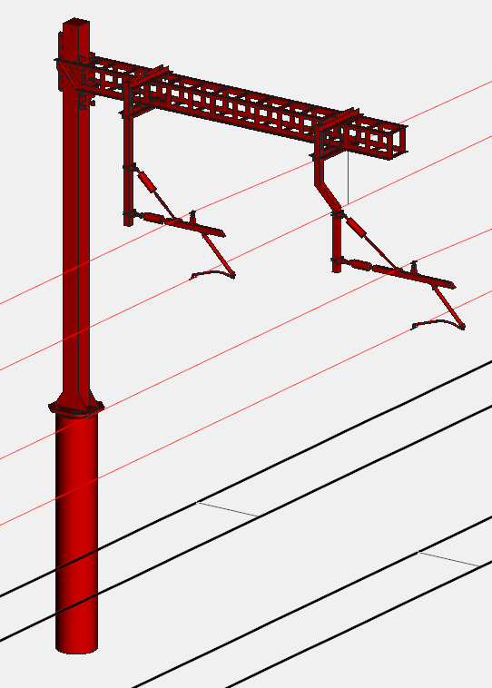

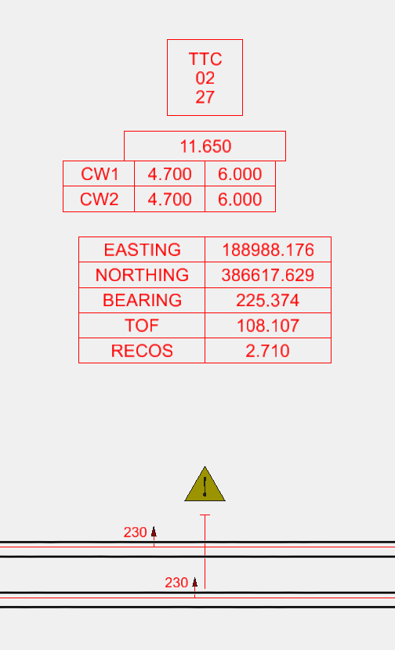
What is Lineardraft?
Lineardraft is software that is redefining OLE/OCS design by…
Replacing traditional, labour-intensive manual design workflows with an intelligent, automated process
Enabling engineers to design in 2D and 3D simultaneously, minimising rework and communication errors between design stages
Embedding BIM asset and allocation data directly in the software, updating it live with every click
Supporting engineers of all experience levels

Slide 2



Out with the old, in with the new…
Traditional Design
Lineardraft Design
Create initial design manually in 2D
Draft 3D OLE/OCS components manually
Replicate 2D design into 3D on a structure-by-structure basis
Make changes and fix errors through labour-intensive revisions
Manually add detailed design elements
Manually input allocation data
Manually enter BIM asset data
Make revisions to data manually following each update or change
Receive updated location data from site, manually move and edit each structure manually move and edit each structure
Automated, simultaneous design in both 2D and 3D (as one is updated, so is the other)
Use of pre-modelled design catalogues with OLE components, including embedded allocation and BIM data
Automatic updates to allocation and BIM asset data in real time, reflecting any design changes
Rapidly make edits with live previews to structures & wires
Automated tools to copy, move, multi-copy, multi-move and move structures to as built co-ordinates

Slide 3
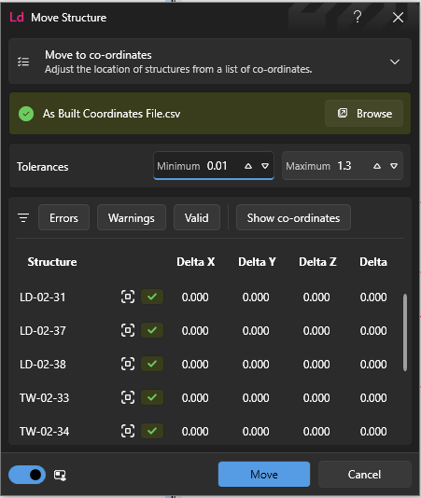
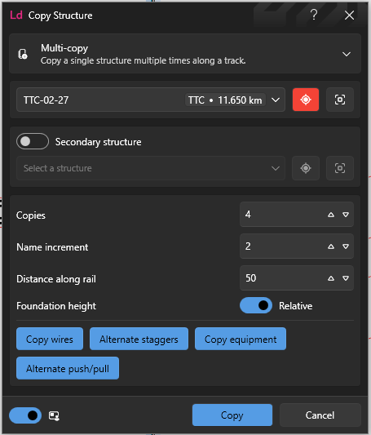
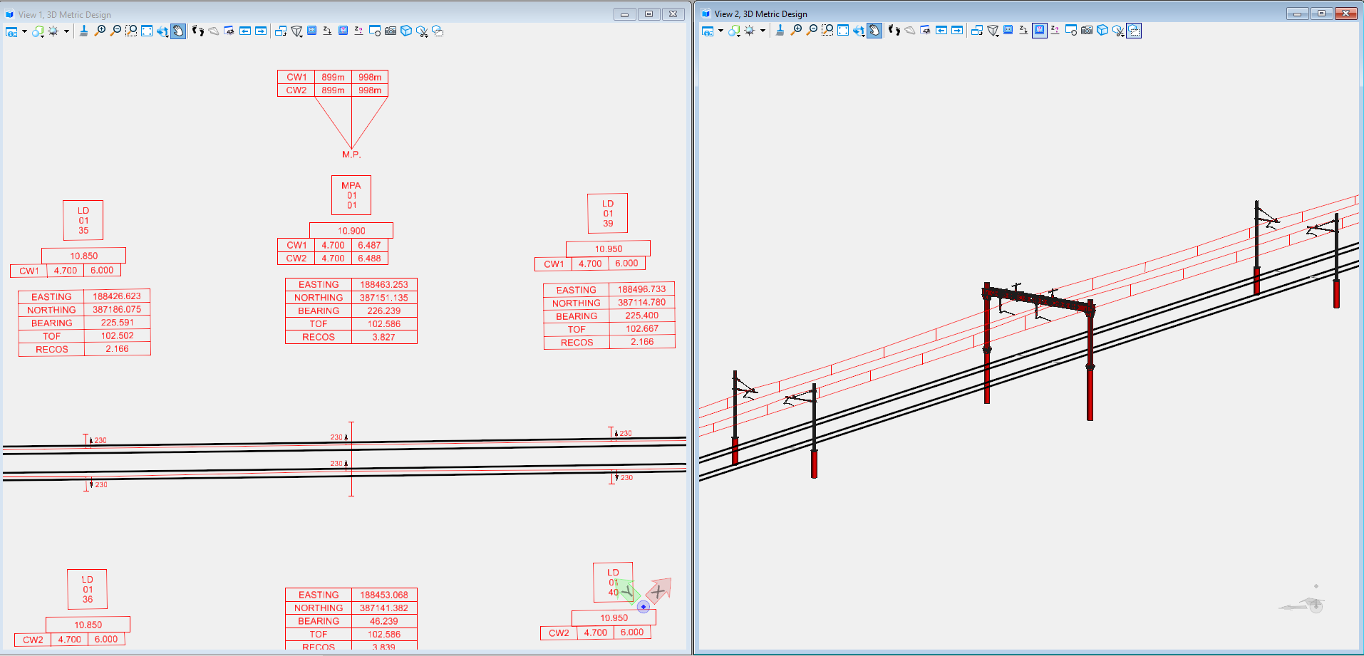
Simultaneous 2D & 3D OLE/OCS Design
Automated Design
Consistent, compliant drawings with an accurate model, whilst working in both 2D & 3D
All changes automatically applied to both 2D & 3D views
Minimises iterative design
Minimises communication error between 2D & 3D design
Eliminates manual design errors
Supports engineers of all experience levels
Create and make complex change in minutes
Automates copying, moving & asset tagging
Adds allocation automatically
Maximises capacity & efficiency

Slide 4



Increasing Workflow Efficiency
Example;
Make a change to an isolated structure (update stagger, move along track)
Lineardraft Design
Customers reported on a recent UK rail project….
Task | Traditional Method | Lineardraft Method
Repositioning a structure on a layout and update annotations | 10 Minutes | 2 Minutes
Repositioning the structure in 3D | 10 Minutes
Reconfigure the cantilever for the new wire positions/cant etc. | 30 Minutes
Totals | 50 Minutes | 2 Minutes
Design cost savings
Time saved on design programme
Design-related site visits

Slide 5
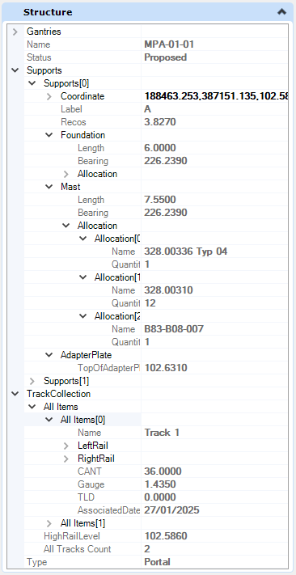
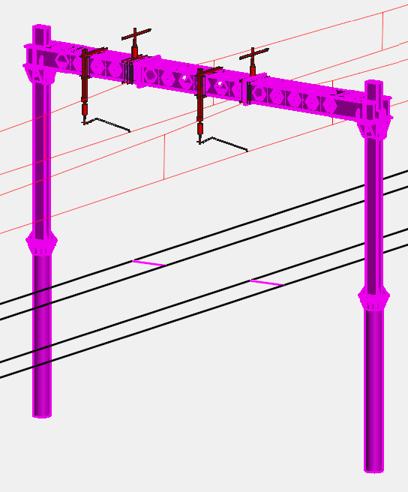
Embedded BIM Asset & Allocation Data
As each item is created, Lineardraft embeds rich asset data in the background, if an item is changed, Lineardraft automatically updates the data to match
What does that mean?
Creates and updates with every click
Allows users to effectively manage change
Import custom asset data for structures in a design

