Slide 1


ERCI10 EU Rail Clusters
ERCI Innovation Awards 2025
Sustainability Accelerator
leadership and export development

Slide 2
Leadership and Export Development Programme
Generating exports through rail Social Value
Help engineering and technology companies sell into global infrastructure projects.
Transform local communities along the lines, around the world.
Leverage UK and EU leadership on sustainability
Address obsolescence through principles of life cycles and ‘circular economy’
Co-design social value projects around stations and construction sites
Develop sustainability mindsets and culture
Shift supply chains beyond compliance to value creation
Boost procurement scores to secure contracts

Slide 3
Partners support underpinning research
The Sustainability Accelerator is developed with support from:
Aston University, including Aston Business School, Energy and Bioenergy Research Institute, and Aston India Centre for Applied Research;
University of Birmingham, including Birmingham Business School, Birmingham Centre for Rail Research and Education, and College of Life and Environmental Sciences;
Open University Business School, Tin Ventures;
The IDG Foundation Stockholm, including supporters Lund University and Massachusetts Institute of Technology; Welsh Government, Nature Scot, Lancaster University, Alef Trust (with Liverpool John Moores University);
Greater Birmingham and East Midlands Chambers of Commerce.

Slide 4
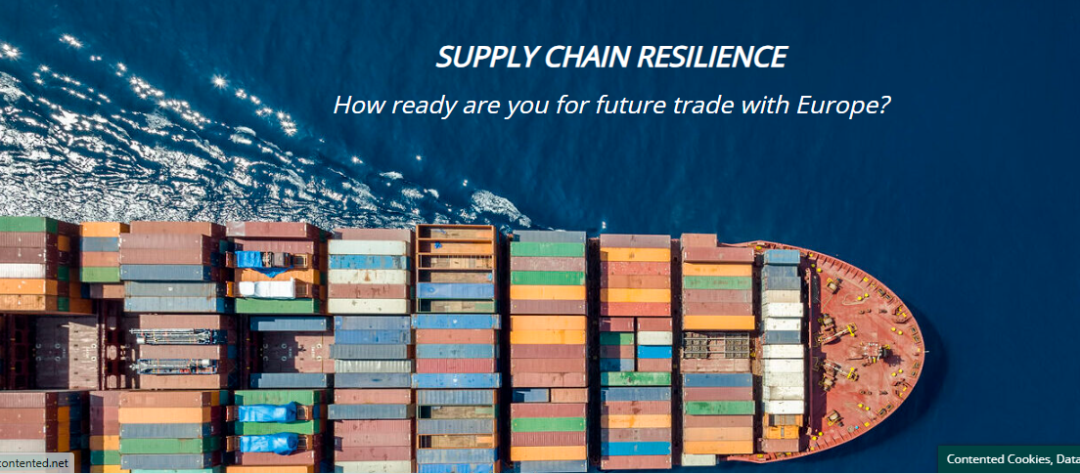

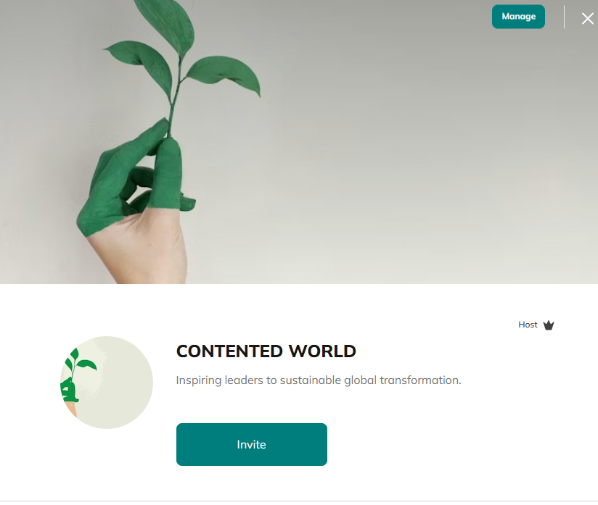
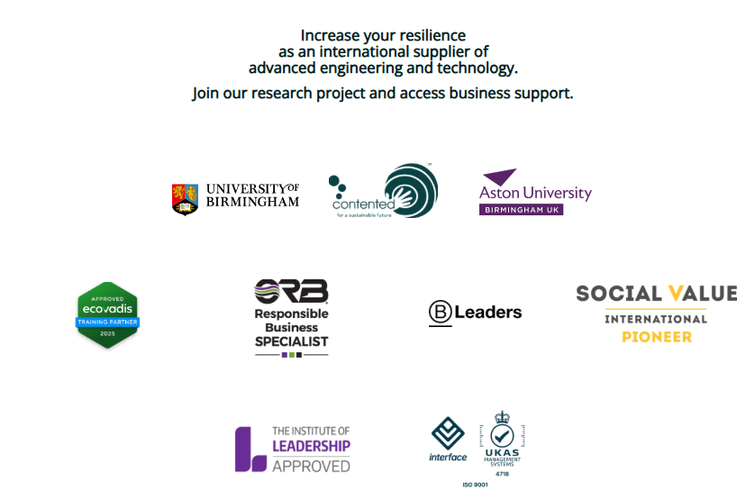
Research Webpage & Learning Platform
https://contented.net/international-supply-chain-resilience

Slide 5
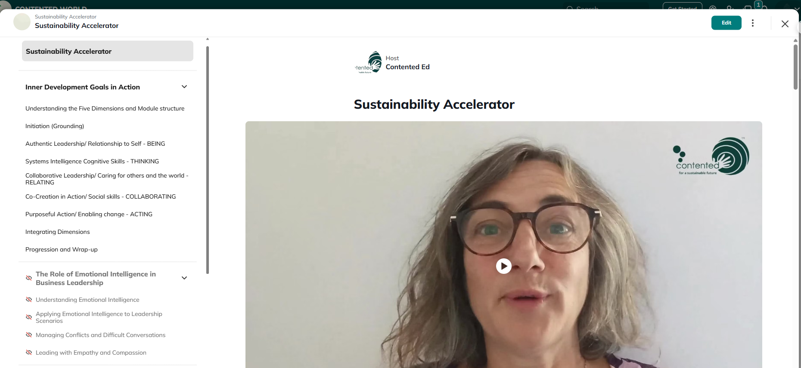
Innovation Overview
Sustainability Accelerator: From Compliance to Value Creation
Transforms ESG from a reporting obligation into a leadership capability
Enables organisations to shift perception from costs to investments
Our Approach
  Integrates systems thinking, Inner Development Goals (IDGs), and peer learning
  Builds internal capacity for sustainable transformation
  Supported by grant funding to amplify impact
Community of Practice
  Established a platform for sustainability practitioners
  Facilitates connection, idea exchange, and co-creation of solutions
Impact
  Empowers businesses to embed leadership and resilience in supply chains
  Contributes to real-world environmental and social change

Slide 6
Innovation
Sustainability Accelerator: An Integrated Platform
Combines leadership development, reflective practice, systems thinking, and action learning
Creates a unified platform for holistic sustainability leadership
Innovative Integration
Among the first programmes to integrate:
Inner Development Goals (IDGs)
Archetypes at Work framework
Advances leadership capabilities specifically for sustainability
Community of Practice
Enables cross-industry peer collaboration and knowledge exchange
Builds ecosystems of innovation through shared learning and co-creation
Operational Maturity (TRL 7)
System prototype successfully tested in real-world environments
Piloted with clients across rail, engineering, and the public sector
Prototyped among practitioners in the UK, India, and Mexico
Now being scaled for broader commercialisation
What Sets Us Apart​
Goes beyond traditional ESG training or consulting models​
Offers a transformative model of practice-based leadership development​

Slide 7
Benefits and Impact
Key Benefits of the Sustainability Accelerator
Improves ESG ratings (e.g. Ecovadis, CSRD readiness)
Boosts public tender success (PPN06/21, Social Value)
Reduces compliance risks and operational costs
Enhances employee engagement and attracts talent
Enables faster green finance access and value chain resilience
Why Contented Stands Out
Positioned at the nexus of leadership & ESG transformation
Trusted credentials: Ecovadis Partner, ORB Certified, ISO 9001
Sustainability embedded in our culture and practice
Offers MBA & EMCC pathways for long-term leadership growth
Delivers measurable, system-level impact
Broader Societal Impact
Aligns with EU Green Deal & UN SDGs
Advances leadership for sustainable infrastructure
Promotes inclusion, climate resilience and green economy goals
Fosters cross-sector collaboration through our community of practice

Slide 8
Programme purpose
Facilitate transformation to safer and more sustainable strategies and operations: shift beyond compliance to increase company value.
Explore inner development and address cultural challenges in supply chains.
Transform communities along the lines by designing collaborative social value projects.

Slide 9





Ethical frameworks
Institute of Leadership
IDG Foundation
Schumacher Wild
European Mentoring and Coaching Council
British Association for Counselling and Psychotherapy
Association of Sustainability Practitioners

Slide 10
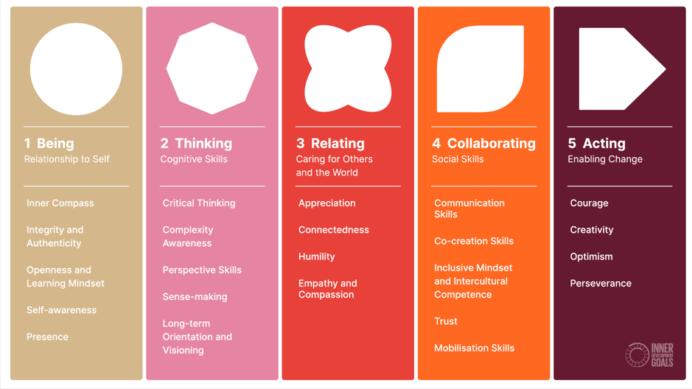

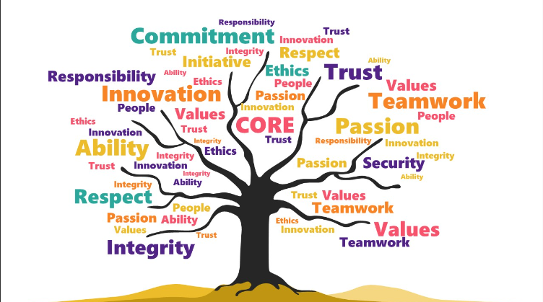
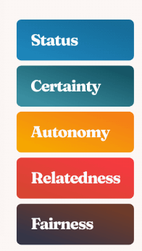
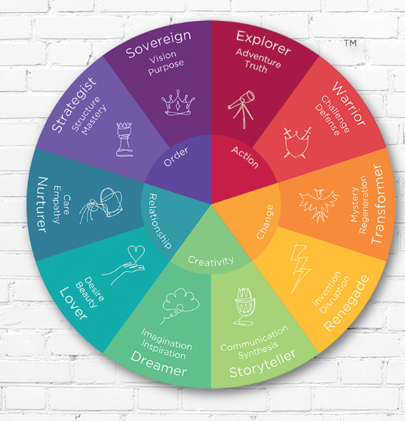
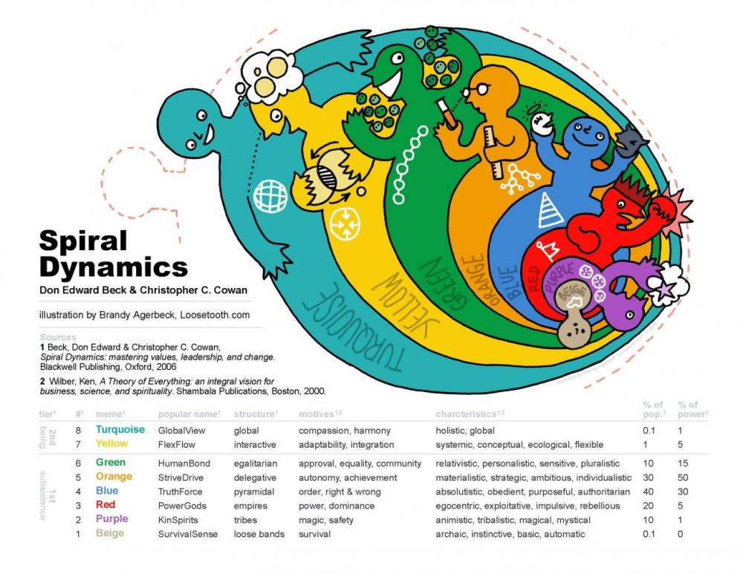
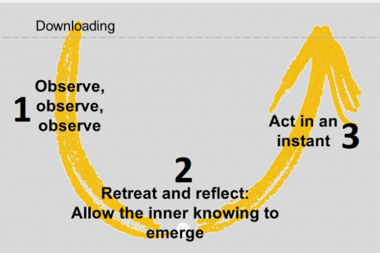
Seeing challenges through different lenses
Immunity to Change
systemic, circular, ecological thinking
motivating and influencing
values;
mindfulness
avoiding polarisation,
seeking new perspectives

Slide 11
Peer-Peer (Action) Learning steps
Present an urgent and significant issue from your client work, for which you are willing to seek help from the group.
Explore themes and select one for demonstration.
Issue-holder re-presents (others listen)
Others ask questions to clarify (issue-holder listens)
Group identifies possible solutions
Issue-holder commits to an action and reporting back next session
Group reflects on the process

Slide 12
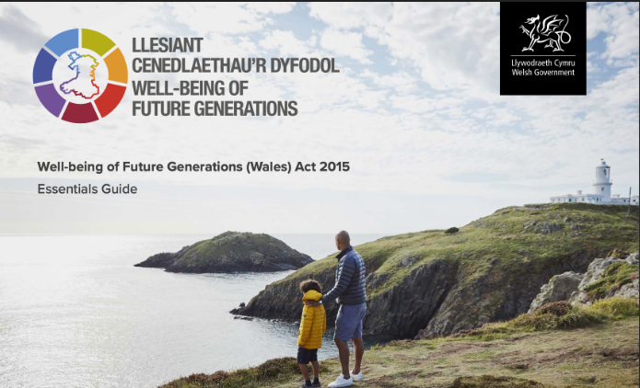
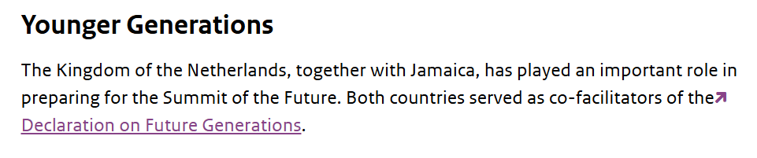



Slide 13

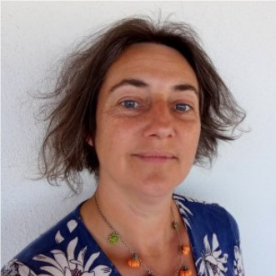
For further information
Please contact :
gerard.davies@contented.net
michelle.furtado@contented.net
+44 79-7681 1506
+44 121-8181 823
Thank-you!

