Slide 1
Euston MRF - Material recovery facility

Slide 2


Video on the Euston MRF
Mitie - Euston Sustainability

Slide 3
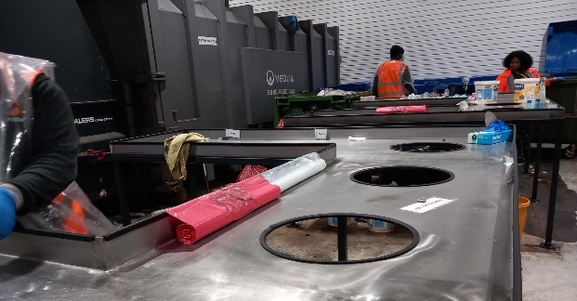
Challenge
Following the retention of the Network Rail account in June 2023, Mitie Waste was tasked with supporting their major hubs, starting with London Euston, to increase recycling levels, deliver cost savings, increase rebates and support retailers within the stations to move to more sustainable practices. London Euston station produces the most waste of any managed station in the UK, c.138 tonnes each month, rising considerably during seasonal periods such as Christmas.
Data obtained via Mitie’s Waste Management Information system, WR1, was analysed, alongside waste composition analysis from controlled tips and bin dives. Mitie was able to identify significant volumes of recyclables being included in the general waste stream – this included paper, cans, glass and plastics, which were going to incineration, rather than being recycled.
Following the crucial step of understanding the current composition of the general waste and dry mixed waste streams, the key to improving the current situation was to engage with clients and their onsite tenants and retailers to increase awareness, and to educate them on correct disposal in line with appropriate waste streams.

Slide 4
Solution
Following a detailed cost-benefit analysis, Mitie Waste recommended a trial of a modular mini–Materials Recycling Facility (mini-MRF) system at Euston station, which included additional resource to operate the system. This was agreed and commissions in October 2023.
Trackersack system implemented across all retailers within the station. They were provided with barcoded bags, that are then collected back once full by Mitie operatives and are scanned and weighed. The waste type and weight are then allocated to that bag/retailer. This means that they can be charged correctly for disposal and can monitor the level of waste and recycling rates from each retailer.
The waste from these bags is brought into the sorting station. All liquids are removed, and waste is segregated by material type for example card/paper, aluminium, plastic, film etc.
The segregated materials are then consolidated via compactors and balers.
Collections are arranged and the materials are transported directly to the on-site processing facility.

Slide 5
Results
At the outset, 138 tonnes of waste were being collected from Euston, through 45 collections per month.
After the first 4 months of trial waste costs had reduced by 50% versus historical spend. This has been achieved through driving volume reductions in general waste, to capture saleable commodities (card, plastics, cans etc). Liquid contamination is also captured and safely managed.
Overall recycling performance at Euston Station has increased from 10% to 81%, and collections have decreased by 70% offering carbon reduction from reduced vehicle movements. GW collections have gone from 5 collections a week to 1, offering an annual carbon saving of 11,242.4 tonnes CO2e since the MRFs implementation.
Rebates are now being claimed against recycling goods that were previously being sent to incinerators; as an example, for each tonne of aluminium baled (approx. 1.5 bales), a rebate of £900 is claimed, which is ploughed straight back into the station to offset the costs of keeping the mini-MRF in operation.
The end of year forecast is a 74% reduction in costs - zero to landfill will be maintained throughout.

Slide 6
Next steps
Ongoings reviews are conducted to analyse the composition of the remaining waste. supporting retailers and contractors with strategies to reduce overall waste. We will also continue to work with retailers to understand the origins of their waste, to further drive awareness and education around waste reduction, improving reuse and recycling rates.
Eleven other Network rail sites will commit to the same investment and operation allowing end-to-end support for different lines. Next stages of the project will include wider roll-out of the tracker-sack system, whereby barcoded bags are provided to retailers which are weighed on receipt within the resource management centre facilitating a ‘pay as you throw’ system – accurate billing is then based on weight and cost of waste bags presented from each retailer.

