Slide 1



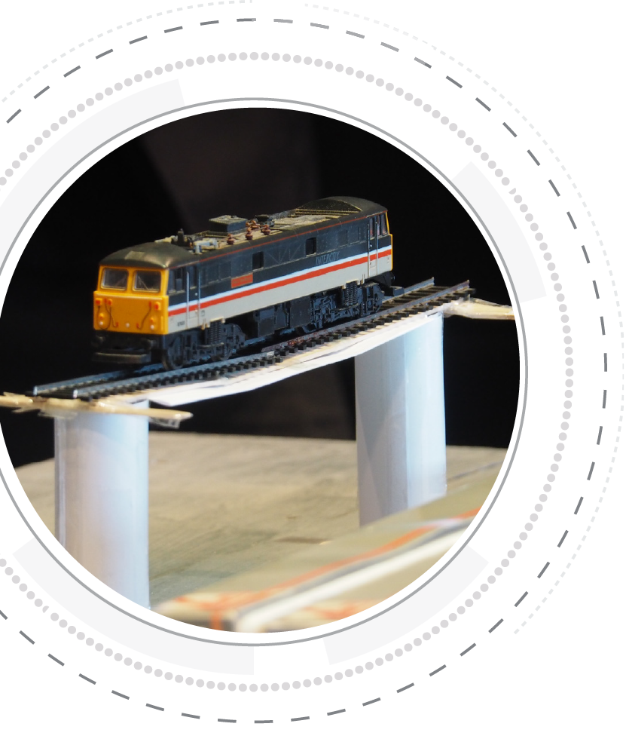

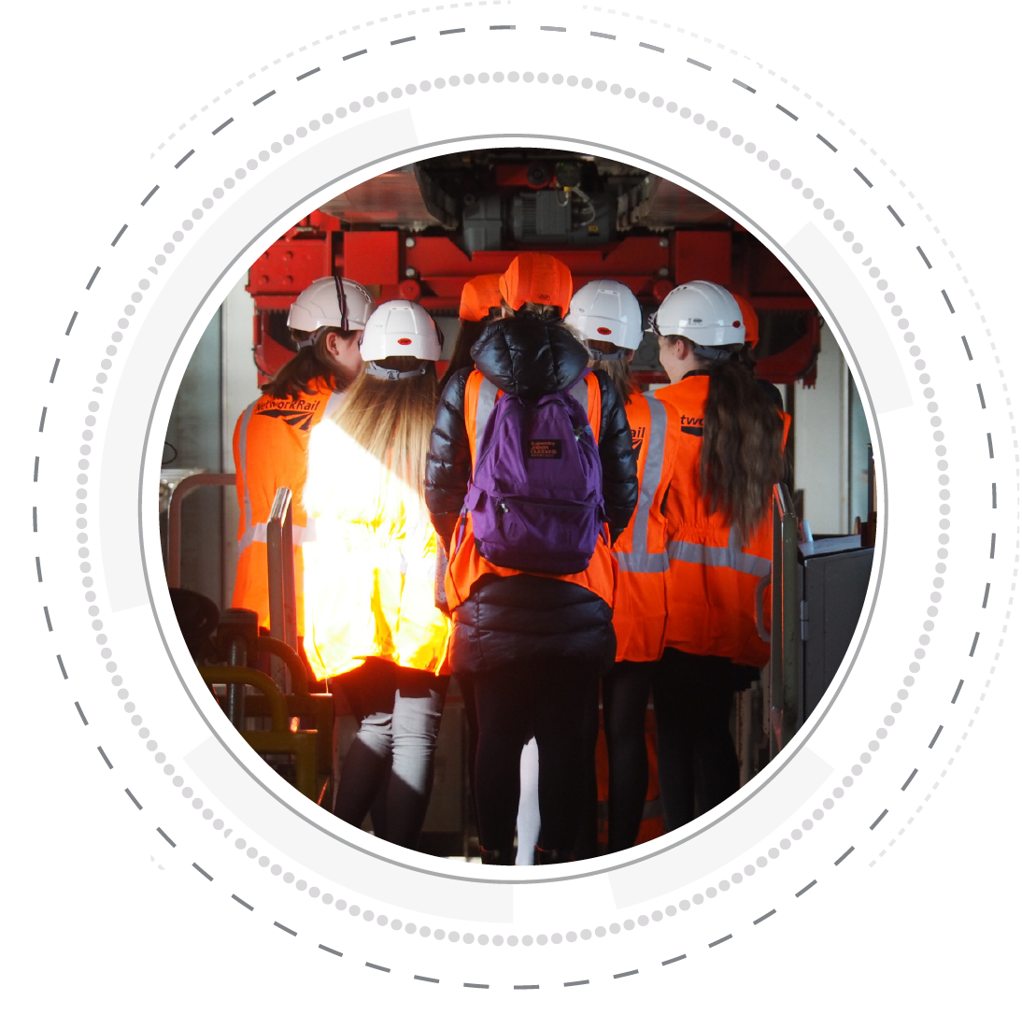
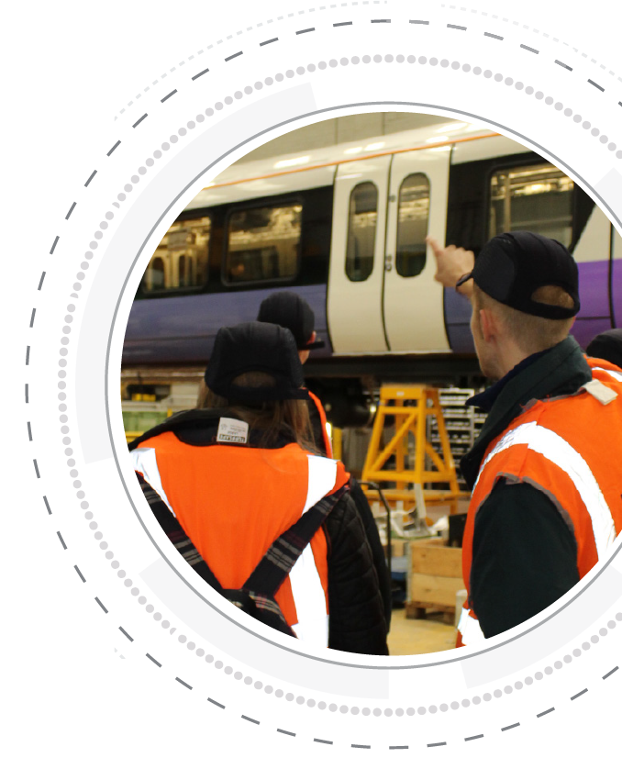


Name:
Project Submission
Workbook

Slide 2

Project Submission
Please complete the following questions as part of your project submission:
Who is in your team?
What is your team's name?
Why have you chosen this team name and how does it represent your team?
Who will take on each role within the team?
Project Role | Name/s | Skills required | Reason for choosing this person
Project manager
Researcher
Designer
Admin and Finance
Marketing

Slide 3
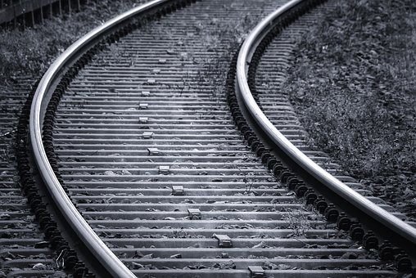
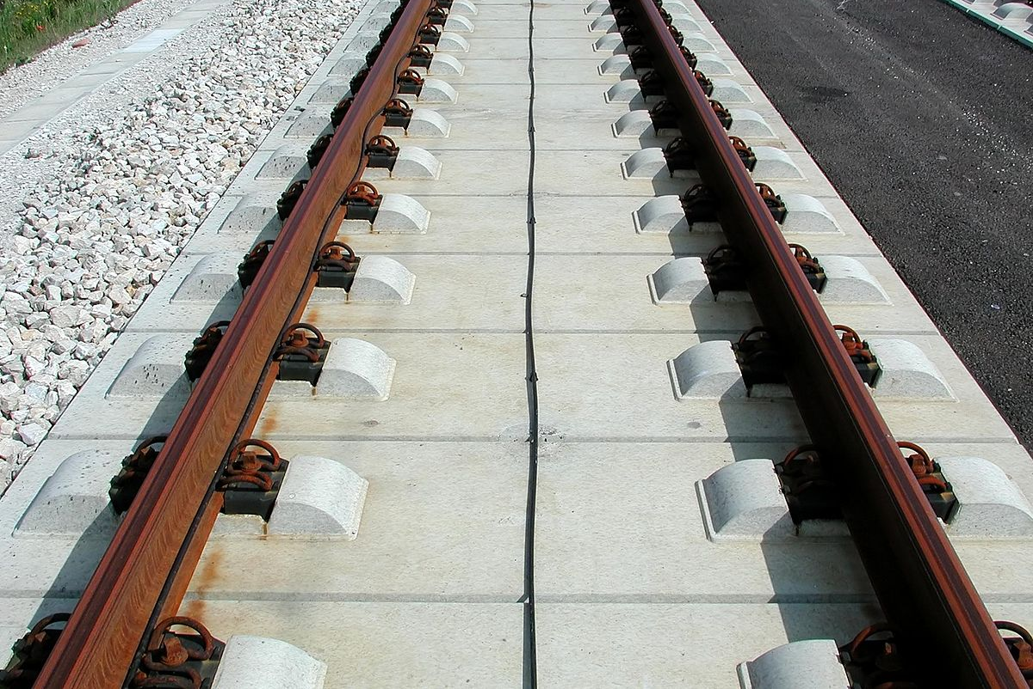
Career Hunt Challenge
1.True or false? The worlds oldest continuously
working railway is Middleton railway in Leeds.
……………………………………………………………………….
2. List 3 rail projects happening in the UK
…………………………………………………………………………………………………………………
…………………………………………………………………………………………………………………
…………………………………………………………………………………………………………………
3. Working in the rail industry which of the following jobs could you do?
Signal engineer
Surveyor
Chef
Sales Assistant
4. Which of the two images shows a track suitable for high-speed trains?
5
points

Slide 4
Career Hunt Challenge
10
points
Crack the codes:
vjgtg ctg ocpa ectggtu nkpmgf ykvj vjg tckn Kpfwuvta.
THE
eqnl dmfhmddqr sn cqhudqr, bnnjr sn bkdzmdqr, zmc
FROM
zbbntmszmsr sn dbnknfhrsr.
Wkhuh'v vrphwklqj iru hyhubrqh!
THE
6. What is Hydroflex and how does it work? Answer in full sentences
………………………………………………………………………………………………………………………………………………………………………………………………………………………………………………………………………………………………………………………………………………………
7. Complete a team SWOT analysis
You must have 1 word for each member of your team in each box
Strength – what are you good at? | Weakness – What could you improve?
Opportunity – what could help you improve? | Threat – What would stop you from reaching your goal?

Slide 5
8. Design a pattern for the fabric of a train seat

Slide 6
Career Hunt Challenge
15
points
Find the job description of each person and match
them to one of the following careers:
Eliza
Jeremy
Shamina
10. Construct a bridge at least 30 cm long. Using 3 sheets of paper.
You cannot use tape!
11. What London underground line would you take to travel from:
Heathrow terminal 5 to Russell Square
…………………………………………………….
Kings Cross to Elephant and Castle
………………………………………………………….
Baker Street to Watford
…………………………………………………………………………..
Engineer Student Placement | Project Manager | Train driver
Surveyor | Ticket Sales Assistant | Data Scientist

Slide 7
Your team has been tasked with extending a train line. You have a maximum budget of £100 million. There is a large city to the northeast of the map, your train line will bring better transport links to the community and so you will need to consider their needs when planning the route.
Each 1cm of track on the map is equal to 500m. This will cost £1.5 million to build.
To cross a river, you will need to build a bridge, bridges cost £2 million
When a train track splits it requires a complex system called “points” to enable trains to be able to go along both parts of the fork. A set of points will cost £7 million
A station will cost £10 million. There is a station at grid reference 37, 06. You must place a station at 40, 13. You may place more stations if you think it will benefit the local community.
 | Cost | Amount | Total
Track/500m | £1.5 million | cm
Points | £7 million
Bridges | £2 million
Stations | £10 million
 |  | Total

Slide 8
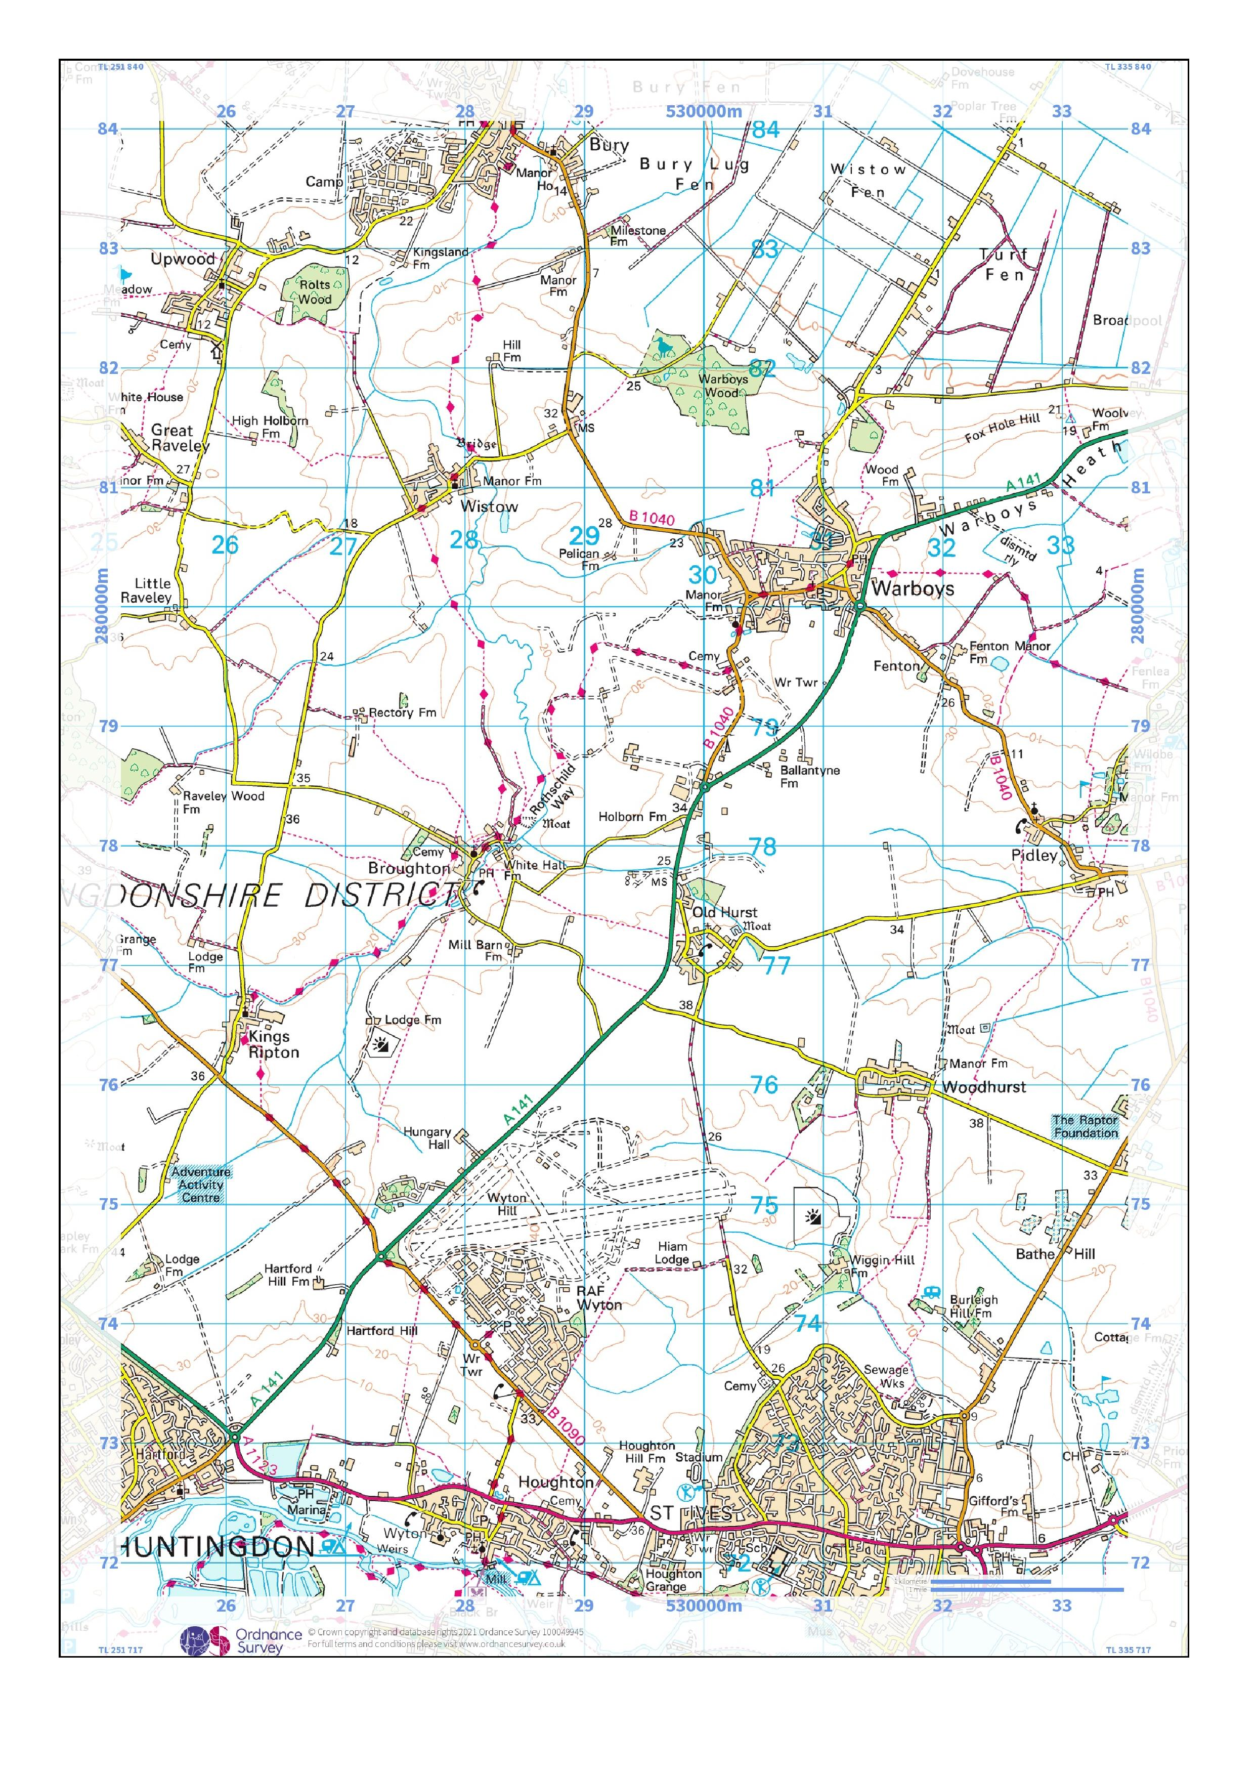
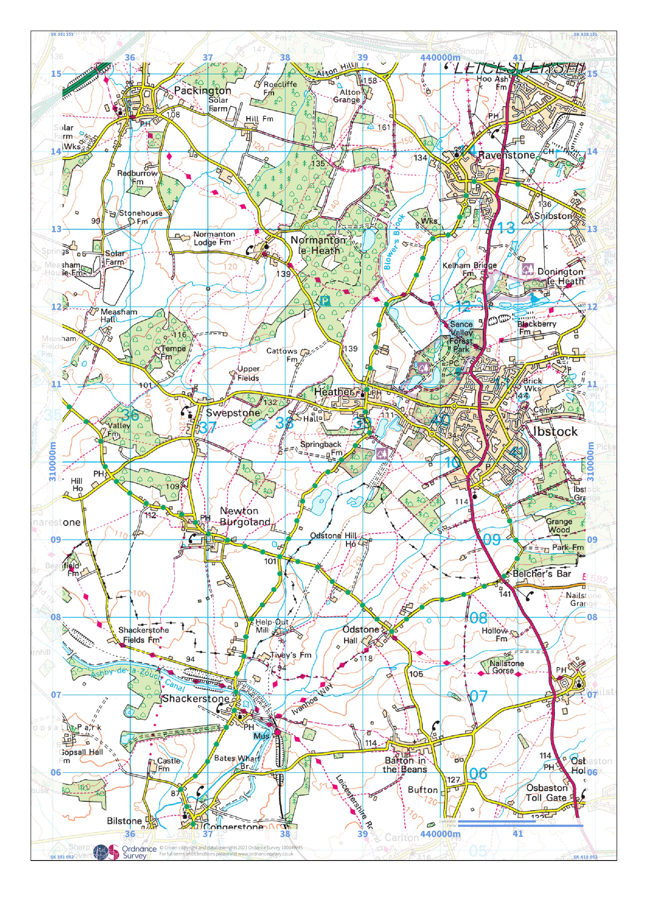

Slide 9
How much does your train route cost?
What effect on the environment will your train route have?
What key elements does your team think a station needs?
Who will use your station? List the types of customer who will use the station and how they will use it. What will they need to make their customer experience enjoyable?
Customer | Use of the station | Station facilities they will use

Slide 10
You need to ensure that your station design is accessible for people with disabilities, list below any disabilities you are aware of and what you would need to build into your design to accommodate for these.
Make a list of the staff members that will work in the station, how they will use the station and the facilities they may need.
Disability | Design Considerations
Staff member | Use of the station | Station facilities they will use

Slide 11

Innovative product ideas

Slide 12
Final Product Design

Slide 13
Station Mood Board

Slide 14
Budget Sheet
Item | Cost | Customer Satisfaction Score | Income
TOTAL
What is your budget? …………………………………………………
What is your expenditure? …………………………………………….
What is your expected income? ………………………………………..
Does your station make a profit? ……………………………………..
Notes:
These are just some of the possible careers. Check out https://nationalcareers.service.gov.uk for more information on these careers.

Slide 15
Think about your team’s strengths and weaknesses:
Take away tip: ………………………………………………………………………………………………………………………………………………………………………………………………………………………………………………………………………………
Presentation notes:
Strength | Weakness

Slide 16
Peer Review Voting Slip
TEAM | PRESNETATION SKILLS /10 | INNOVATION/10 | INCOME | CUSTOMER SATISFACTION | TOTAL
Our winners:

